Slide 1


2023-2024 Initial ELPAC and Initial Alternate ELPAC Administration Coordinator Training
This PowerPoint is available on the Student Testing Branch Website in Coordinator Resources https://www.lausd.org/testing
This presentation will be used to facilitate your school-based training.

Slide 2
Reminders…
Information provided in this presentation is subject to change.
This presentation must be completed in a single sitting.
You must be in attendance for the entire presentation to receive credit.
Attendance will be tracked based on your total time in the Zoom session.
Completion will be recorded on MyPLN and reflected in the Principal's Portal.

Slide 3
Agenda
Before Testing​ | During Testing​ | After Testing​
Important Information for Coordinators​ Critical Information and Timeline ​ Data Readiness​ Training Requirements ​ Moodle Training​ Monitoring Completion of TE Requirements​ ELPAC TOMS Accounts ​ Accessibility Resources​ Entering Supports, Accommodations, and Domain Exemptions​ Technology ​ | Monitoring Completion​ Preparing for Test Administration​ Creating a Test Session​ Initial ELPAC Test Administration​ K-2 Reading and Listening​ K-2 Writing​ K-12 Speaking​ 3-12 Reading, Listening, and Writing​ DEI and THSS​ Initial Alternate ELPAC Test Administration​ STAIRS​ | Returning K-2 Writing Materials​ Score Reporting​ Post-test Documentation​ Crisis Alert Response System (CARS) and Audits​ New! ELPAC Interim Assessments​ Resources​

Slide 4
Before Testing:
Critical Information and Timeline

Slide 5
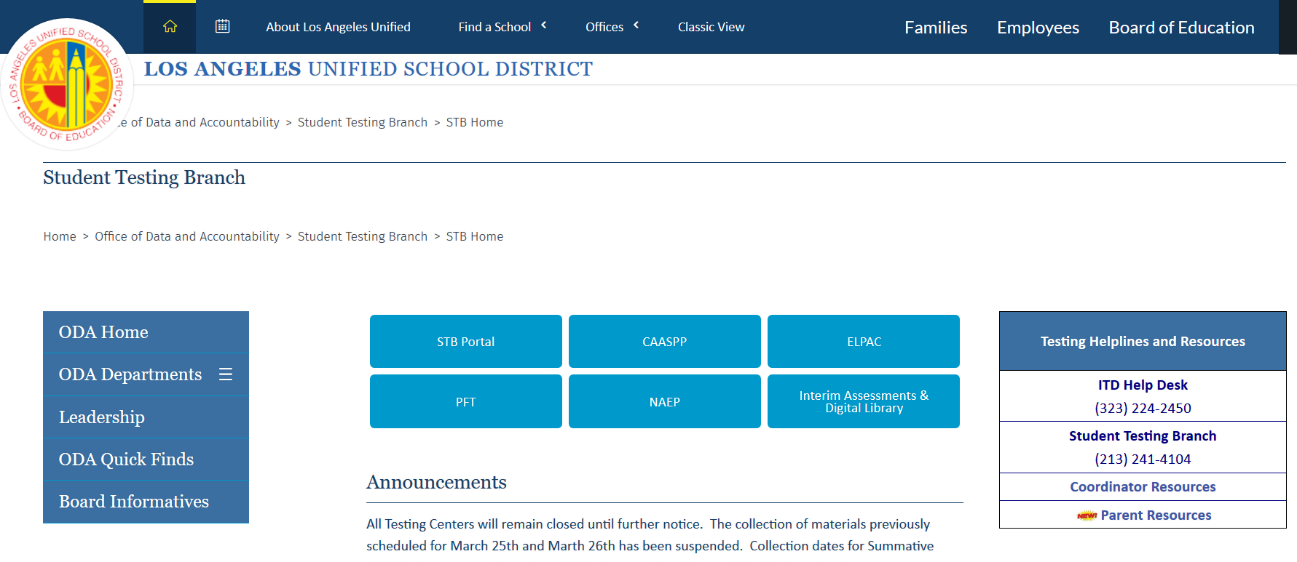
STB Website
https://www.lausd.org/testing
The STB Portal is only accessible through the STB homepage and while logged into the LAUSD Network.
1
Notes:
Bookmark the STB Portal

Slide 6
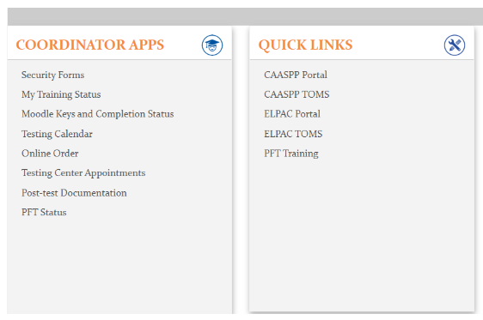
STB Portal
Access Security Affidavits and Reports.
Review YOUR completion of training requirements.
Access Moodle Keys and Moodle completion.
Order additional K-2 Writing Answer Books.
Upload post-test documentation.
The STB Portal can only be accessed via the LAUSD Network or VPN.
Notes:
The STB Portal assists coordinators with managing testing, verifying completion of training requirements, accessing Moodle keys, ordering additional materials, and uploading post-test documentation.

Slide 7
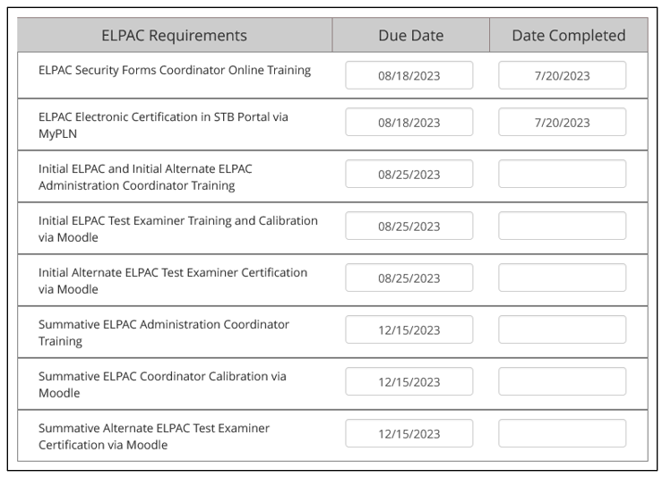
STB Portal-My Training Status
Notes:
The My Training Status page displays the ELPAC Coordinator’s Completion of Training Requirements (there is a delay for the information to sync)

Slide 8
STB Coordinator Resources
https://achieve.lausd.net/testing
2
Notes:
Bookmark the Coordinator Resources page as it contains valuable resources and information for coordinators.

Slide 9
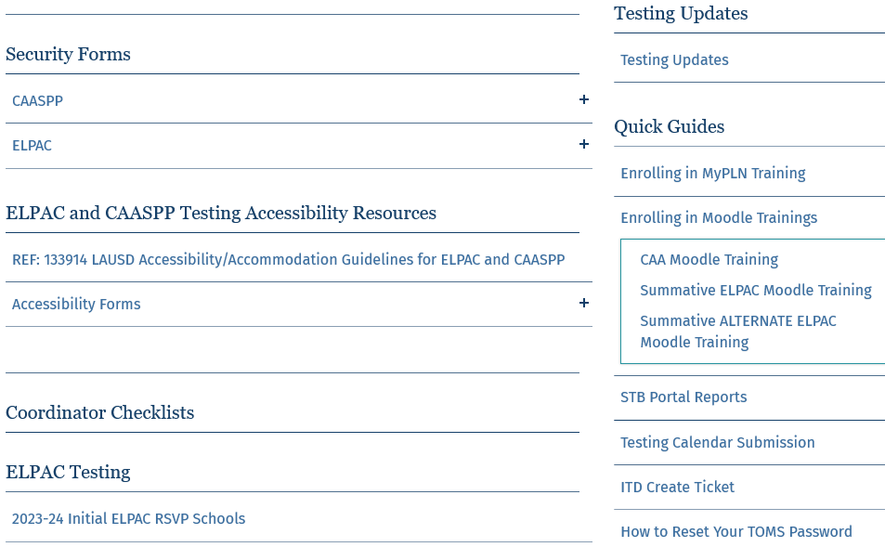
STB Coordinator Resources
Affidavits for non-district BIIs.
Accessibility Resources Documentation
RSVP School List
Notes:
New Resources are added throughout the year.

Slide 10
Coordinator Support
Office Hours for ELPAC Coordinators
  Receive support from STB Administrators
    Have this presentation available to refer to during
  Starting August 28
    8:30 am – 9:30 am
    2:45 pm - 3:45 pm (New time!)
      Office Hours will not be available on Friday afternoons.
  Access the link to Office Hours in Coordinator Resources
STB Help Desk
  Mon-Fri 7:30 am – 4:00 pm (excluding holidays)
  (213) 241-4104

Slide 11
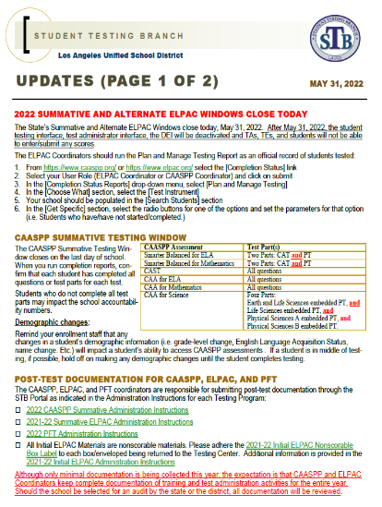
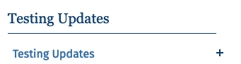
STB Updates
Provides Coordinators with instructions, reminders, and new information.
Weekly STB Update is automatically emailed to:
  Designated Testing Coordinators.
STB Updates can also be accessed through the Coordinator Resources page on the STB Website.
Notes:
Any other individual at the school site who would like to be placed on the Testing Update distribution list will need to complete the 2023-24 Testing Point of Contact Training in MyPLN.

Slide 12
Initial ELPAC Coordinator Checklist
Review the Initial ELPAC Coordinator Checklist to identify key tasks to be completed before, during, and after testing.
  Available in Coordinator Resources
Notes:
The Initial ELPAC Coordinator Checklist is a useful tool that will help you organize key tasks in a timely manner.
Located in Coordinator Resources

Slide 13

ELPAC Website
https://www.elpac.org/
Notes:
The ELPAC Website contains valuable information that you will need to access frequently.

Slide 14
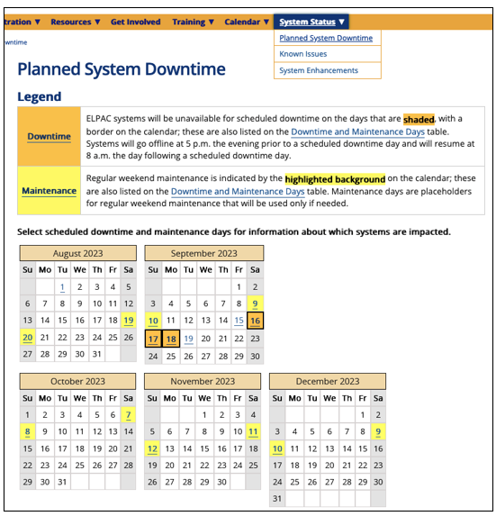
ELPAC Website – Planned Downtime
Indicates downtime and system maintenance dates.
  August 19-20
  September 9-10 and 16-18
  October 7-8
  November 11-12
  December 9-10
Notes:
Mark your calendar for the planned system downtime and maintenance dates. ELPAC Coordinators and Test Examiners will not have access to any ELPAC systems during this time.

Slide 15
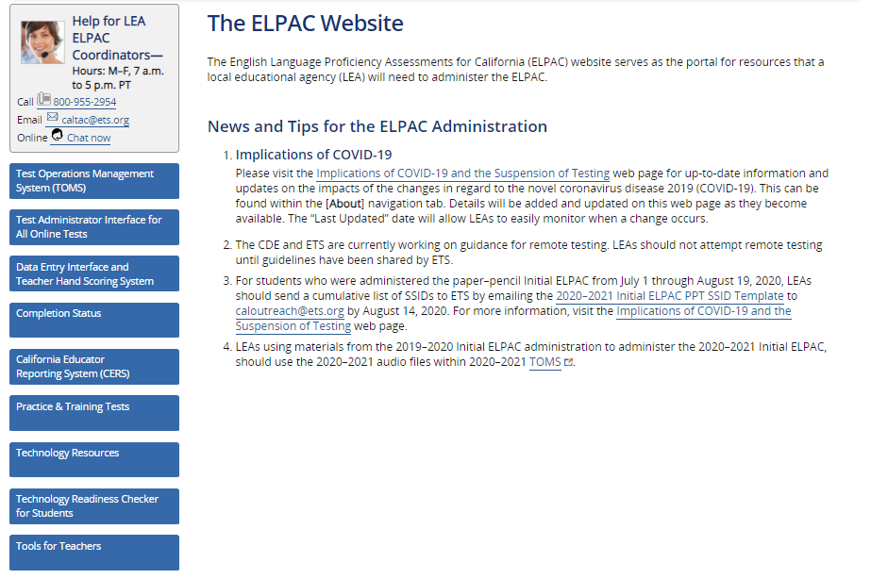
ELPAC Website
Test Operations Management System (TOMS)
Identify eligible students
Create Test Examiners’ Accounts
Access reports
Access Directions for Administration (DFAs)
Submit Test Irregularities and Security Breaches (STAIRS report)
Enter Designated Supports and Accommodations for eligible students
Coordinator TOMS Accounts will be created by STB after all Principal and Coordinator training requirements have been met.
Notes:
TOMS is an important acronym to learn as Coordinators will access this tab frequently throughout the year.

Slide 16
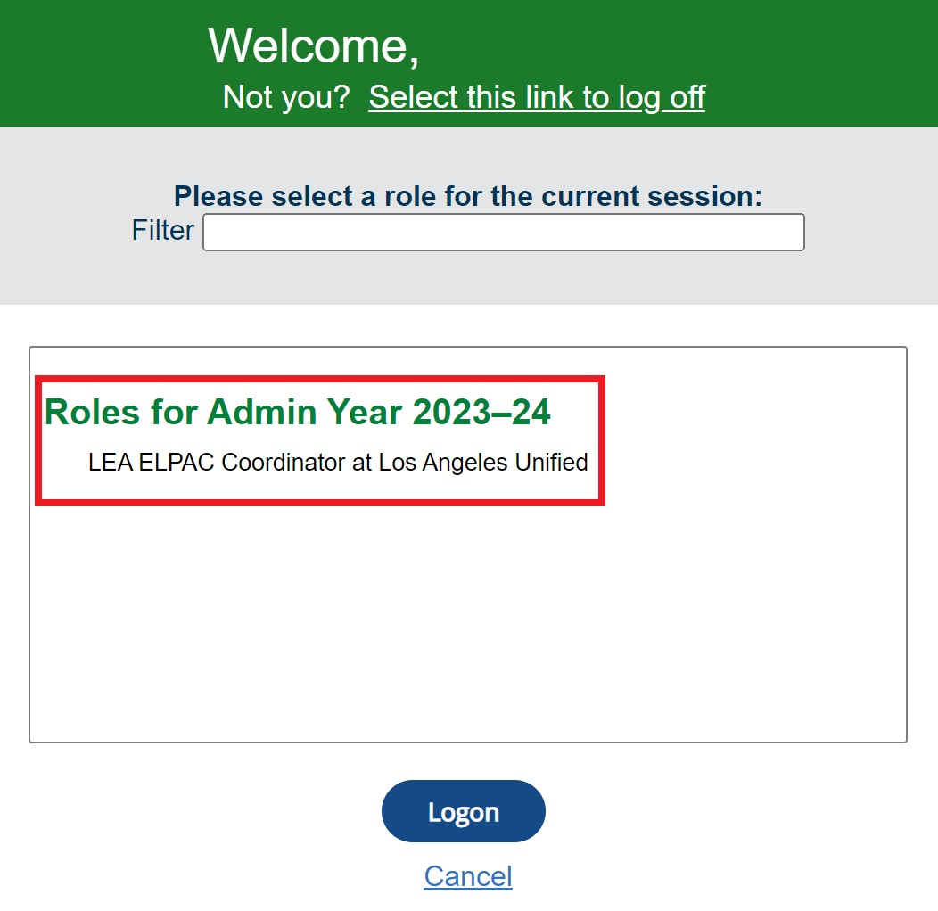
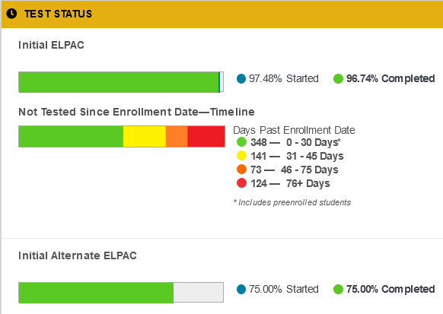
TOMS
Notes:
TOMS landing page proves schools useful information to assist coordinators with managing testing
Once you log into TOMS notice the at a glance information for your school
Count down of days remaining in the testing window
Test Status is displayed by assessment. It provides the percentage of eligible student who have started testing in BLUE. Percentage of students who have completed testing in GREEN.
Not Tested Since Enrollment Date timeline is a feature that you should pay close attention to. It indicates if any students have not been tested

Slide 17
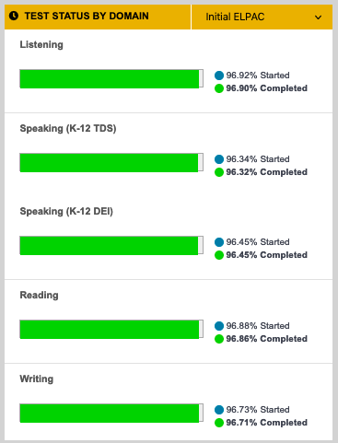
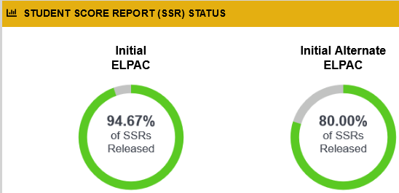
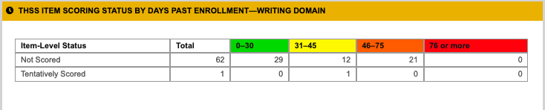
TOMS
Indicates UNSCORED Initial ELPAC Writing responses for students in grades 3-12.
Notes:
Test Status is displayed by domain.
Score Report Status displays percentage of ELPAC scores released by the State vendor.
Teacher Hand Scoring System, know as (THSS), item scoring status by days past enrollment

Slide 18
Action Items
Bookmark the STB homepage, STB Portal, TOMS, and ELPAC websites.
Download the Initial ELPAC Coordinator Checklist.
Note the Planned System Downtime dates.
Save the STB Help Desk phone number (213) 241-4104.
Reminder! Links to Office Hours for Coordinators are on the Coordinator Resources page.

Slide 19
Before Testing
Data Readiness

Slide 20
What is the Initial ELPAC?
The Initial ELPAC is a computer-based language test used to determine the English proficiency of students entering a California school for the first time.
All students in UTK–12 whose primary language is a language other than English, as indicated on their HLS, must take the Initial ELPAC to determine whether they are EL or IFEP students.
  Eligible students take an Initial ELPAC only once in their school career.
Notes:
The Initial ELPAC determines the English language proficiency of students entering a California school for the first time.

Slide 21
RSVP Schools
Some LAUSD schools have been selected by the California Department of Education (CDE) to participate in the Rotating Score Validation Process (RSVP) and submit their completed K-2 Writing Answer Books to the state for second scoring.
RSVP Schools List
RSVP schools will receive scannable K-2 Writing Answer Books.
  Different than Writing Books for non-RSVP schools.
RSVP schools will turn in their K-2 Writing Books for students who completed Initial ELPAC testing between August 14 – October 31, 2023.
Notes:
The State has randomly selected a subset of schools to participate in the Rotating Score Validation Process, known as RSVP. These schools will submit Initial K-2 Writing Answer Books to the Testing Center during the November collection for students tested from August 15- October 31.
Click the link to check if you are a RSVP School.

Slide 22
Key Dates
Initial ELPAC Testing Window | Delivery of Test Materials to Schools
August 14 – September 12 19, 2023 Eligible students who are enrolled the first day of school need to be tested within 30 calendar days of enrollment. Eligible students who enrolled last school year are held to a different timeline. Contact your Region Multilingual Multicultural Academic Language (MMAL) Team for guidance. September 13, 2023 – June 11, 2024 Eligible students enrolled throughout the school year must be tested within 2 weeks of enrollment. Pending SSID Pending the TBD (To Be Determined) status in TOMS. Initial ELPAC window closes on June 11, 2024! | K-2 Writing Answer Books K-2 Initial ELPAC Writing Answer Books will be delivered AFTER the Principal and Coordinator have completed their respective training requirements. Deliveries start the week of August 14. Inventory and securely store upon receipt. Order additional K-2 Initial ELPAC Writing Answer books through the STB Portal. Select ONLINE ORDER Earbuds Deliveries start the week of August 7. Earbuds are for eligible students in grades 3 –12.
Testing Windows and Collection Dates are subject to change.
Notes:
Eligible students must be tested within 30 calendar days of their first day of enrollment.
Delivery of K-2 Writing Answer Books begins August 14. Additional orders can be made by ELPAC Coordinators via STB Portal
Delivery of 3-12 earbuds begins August 8

Slide 23

K-2 Writing Books Turn-in Dates
Materials Will be Turned Into Your Assigned Testing Center TENTATIVE Collection Dates
RSVP Schools RSVP Schools will turn in Initial ELPAC K-2 Writing Answer Books for students tested between August 14 and October 31. Turn-in date: November 15-16, 2023 After the November collection, RSVP schools will securely store all completed and unused K-2 Writing Answer Books until the following collection: June 3-4, 2024 STB will communicate directly with RSVP schools regarding the collection. | Non-RSVP Schools Non-RSVP Schools will securely store all completed and unused Initial ELPAC K-2 Writing Answer Books until the following collection: June 3-4, 2024
Please refer to MEMO 096303.1 : Testing Center Assignments for 2023-24
Notes:
RSVP schools will submit their K-2 Writing Answer Books to STB in November
At the end of the school year, RSVP Schools and Non-RSVP Schools will submit all ELPAC test materials during the June 3-4 collection.
All coordinators will securely store test materials when not in use.

Slide 24
Parent Notification
Poll
Parent exemptions do not apply for ELPAC, however, schools are required to notify parents before testing students.
  Follow Multilingual and Multicultural Education Department (MMED) policy.
MMED will be mailing the Initial ELPAC parent letter weekly (starting August 14th) until September 1, 2023.
    For questions, contact your Region Multilingual and Multicultural Academic Language (MMAL) Team.
ELPAC Coordinators will need to send the Parent Notification for students enrolled after September 1, 2023.
  The Parent Notification letter will be posted on the MMED website.
    https://achieve.lausd.net/Page/180
    EL Programs > Forms
Notes:
According to State Regulations, parent exemptions do not apply for ELPAC. The State requires schools to notify parents before testing begins.
The Initial ELPAC and the Initial Alternate ELPAC notification letters will be available on the MMED website after September 1.

Slide 25
Check for Understanding #1
Eligible students enrolled on the first day of school must be tested within how many days?
30 days
60 days
Eligible students enrolled on the first day of school must be tested within 30 calendar days.

Slide 26
Action Items
Mark your calendars with the Key Dates.
Verify if your school is an RSVP School (Coordinator Resources).
Inventory and securely store your K-2 Writing Answer books upon receipt.

Slide 27
Before Testing
Data Readiness

Slide 28
Initial ELPAC Eligibility
All eligible students must have an SSID with an English Language Acquisition Status (ELAS) of To Be Determined (TBD) in TOMS.
Eligible students will be administered ONE of the following Initial ELPAC Assessments:
    Initial ELPAC
      Consists of 4 domains.
        Listening, Speaking, Writing, and Reading.
        Schools will receive Writing Answer Books for UTK-2 grade students.
      UTK and TK students will be administered the kindergarten assessment.
    Initial Alternate ELPAC
      Initial Alternate ELPAC must be indicated on the student's IEP.
      One comprehensive computer-based test.
Notes:
Eligible students will complete either the Initial ELPAC or the Initial Alternate ELPAC.
Initial Alternate ELPAC must be indicated on the student's IEP or else the student takes the general Initial ELPAC

Slide 29
Who is Eligible for the Initial Alternate ELPAC?
Students who meet ALL of the following three requirements will be administered the Initial Alternate ELPAC:
Student has an ELAS of TBD
Student has a Significant Cognitive Disability
Student has the Alternate ELPAC indicated on their Individualized Education Program (IEP) in FAPE 2 Part 4 prior to the assessment
  IEP Team resources
    Alternate Assessment Decision-Making Tool
    Assessment IEP Team Guidance
After verifying eligibility, Coordinators will assign the Initial Alternate ELPAC in TOMS.
Notes:
There are three requirements for the Initial ALT ELPAC

Slide 30
Which Initial ELPAC Assessment Should be Administered?
Student’s ELAS is TBD in TOMS
Student does NOT have an IEP.
Student has an IEP.
Student will be administered the
Initial ELPAC.
Student’s IEP
DOES NOT indicate the Alternate ELPAC.
FAPE 2 Part 4 of student’s IEP indicates the Alternate ELPAC.
The ELPAC Coordinator will assign the Initial Alternate ELPAC to the student and the student will be administered the Initial Alternate ELPAC.
Notes:
You have verified the student's ELAS is TBD in TOMS.
Next step is to determine which Initial ELPAC to administer.
No IEP, administer the Initial ELPAC
Student with an IEP, however it does not indicate Alternate Assessment, administer the Initial ELPAC
Student with an IEP and FAPE 2 Part 4 indicates ALT ELPAC. Assign Initial Alternate ELPAC in TOMS. Administer the Initial Alternate ELPAC
Students who are in the Pre-School Transition to Kindergarten program may already have an IEP that indicates an alternate assessment. Check the FAPE 2 Part 4 of the IEP or Section K.

Slide 31
Verifying Initial ELPAC Eligibility
Frequently download the Initial ELPAC and Initial Alternate ELPAC Student Eligibility Report in TOMS.
  Cross Reference with MiSiS.
    TOMS information supersedes MiSiS
  Students will be removed from this report once a score report has been generated.
Verify IEPs (FAPE 2 Part 4 or Section K) to identify students who have the Initial Alternate ELPAC indicated on their IEP.
  Work with SpEd Staff
  Assign the Initial Alternate ELPAC to eligible students in TOMS.
  Test Assignment will be indicated on the Eligibility Report when you download it again.
Notes:
To verify eligibility review student demographic data information in TOMS
First, access the Initial ELPAC and Initial Alternate ELPAC Student Eligibility Report
Verify IEP, look at FAPE 2 Part 4 or Section K
Assign Initial ALT ELPAC in TOMS
Students will be removed from Eligibility report once a Student Score Report been generated.

Slide 32
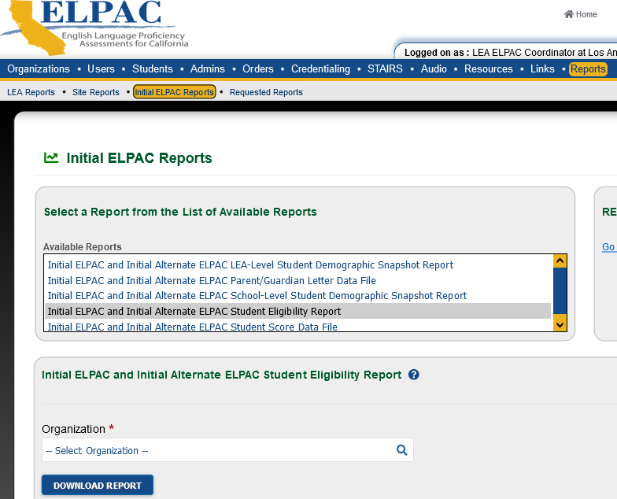
Student Eligibility Report
Initial ELPAC and Initial Alternate ELPAC Student Eligibility Report provides a list of students who must take an Initial ELPAC.
Check this report frequently as new students will not show on this report until after they receive a SSID.
1. Reports
2. Initial ELPAC Reports
The Initial Alternate ELPAC will not be assigned on the report until AFTER the ELPAC Coordinator assigns the test to the student in TOMS.
3. Download the report
Notes:
The Initial ELPAC and Initial Alternate ELPAC Student Eligibility Report is the first report you will want to generate from TOMS.
Download this report frequently throughout the school year.

Slide 33
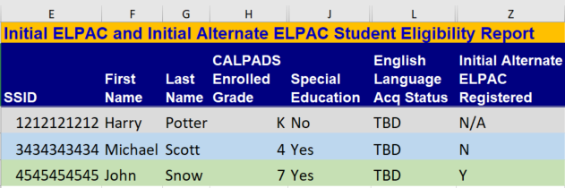
Student Eligibility Report
Student does not receive SpEd services and is not eligible for Initial Alternate ELPAC.
Check IEP.
Student might have Initial Alternate ELPAC indicated on IEP.
Student has been assigned the Initial Alternate ELPAC by the Coordinator.
Notes:
Pay close attention to Column "Z." Students who have a "YES" in this column have been assigned the Initial Alternate.

Slide 34
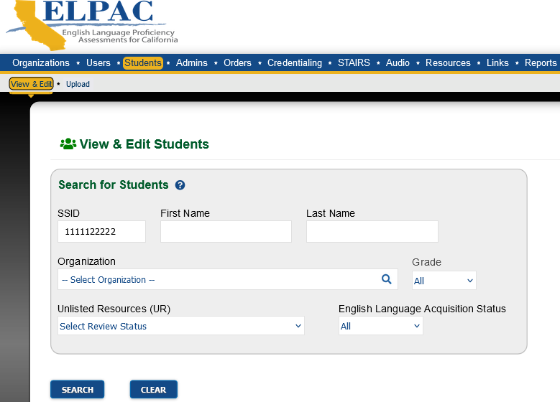
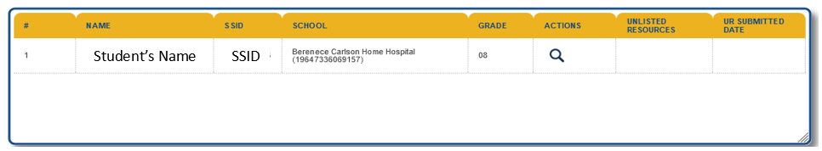
Individual Student Information
Enter SSID to search for individual students.
Search
Click to View
Notes:
To search for an individual Student Profile in TOMS, it is always best to search by SSID number.

Slide 35
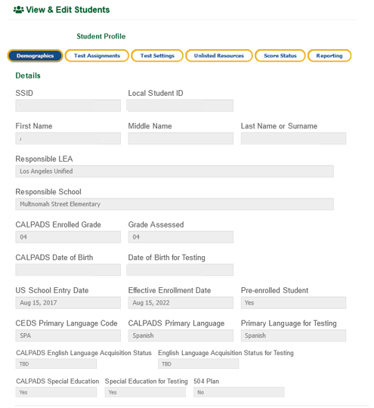
Student Profile Page in TOMS
Verify that the grade level is correct.
ELAS Status must be TBD
  If it is blank, data has not completed syncing.
  If it is EL, IFEP, or RFEP, the student has already taken an Initial ELPAC.
Indicator for Special Education
  Must indicate "YES" for accommodations to be entered or for the student to be assigned the Initial Alternate ELPAC.
    Check for ALT ELPAC designation on IEP
1
2
3
Notes:
Student Profile contains valuable student information. Some of the student data displayed:
Grade level
English Language Acquisition Status, know as ELAS
Special Ed indicator

Slide 36
Assigning the Initial Alternate ELPAC in TOMS
After verifying eligibility, ELPAC Coordinators will assign the Initial Alternate ELPAC to eligible students in TOMS.
  Students ARE NOT automatically assigned the Initial Alternate ELPAC.
  TOMS How to Enter Student Test Assignments One by One Video
Notes:
You are responsible for assigning the Initial ALT ELPAC in TOMS.
See the link listed for instructions on how to enter test assignments by the one-by-one method in TOMS

Slide 37
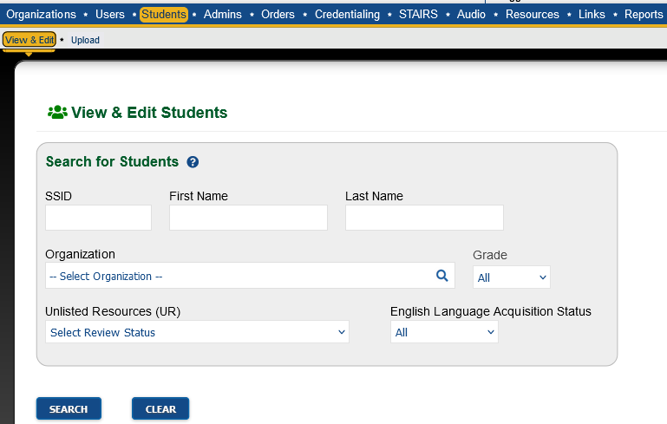
Assigning the Initial Alternate ELPAC in TOMS
1. Enter SSID
2. Search
3. View
Notes:
The next 2 slides list the steps for assigning the Initial ALT ELPAC in TOMS.
Search for the student by SSID

Slide 38
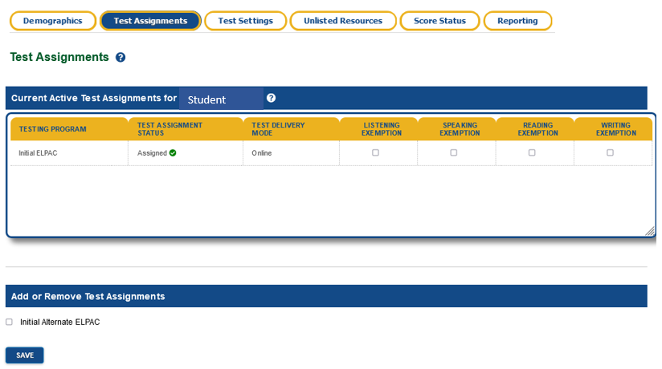
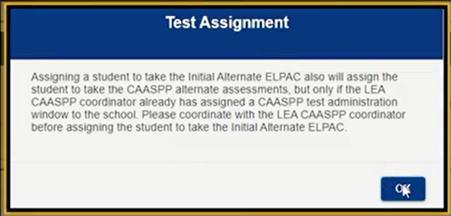
Assigning the Initial Alternate ELPAC in TOMS
Select
Save
Notes:
To complete the process, select Initial Alternate ELPAC box and then click the Save button.
You will need to wait 24-48 hours for the update to process

Slide 39



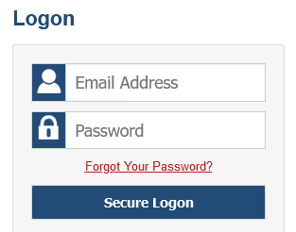


Data Flow
Student-Level
Information
Student Enrolls!
3-5 days
This process is NOT instantaneous!
Coordinator can view student’s demographic info and complete tasks in TOMS.
3-5 days
Student Populates in Testing Platform
If 2 weeks have passed and you are unable to administer an Initial ELPAC to a new enrollee, contact State Reporting Services Branch at (213) 241-2450.
Notes:
Any changes in MiSiS may take up to 10 business days to be indicated in TOMS
Test Examiners need to be aware that changes are not immediately indicated in TOMS

Slide 40
New Enrollees to be Tested Throughout the Year
Continue checking Initial ELPAC and Initial Alternate ELPAC Student Eligibility Report in TOMS WEEKLY.
  Verify/confirm IEPs (FAPE 2 Part 4) for Initial Alternate ELPAC designation.
Do not test new enrollees if they already tested at previous school/district.
  Check Completion Status Portal on elpac.org
If Initial ELPAC scores are not in TOMS, but student is listed as an EL in MiSiS, contact the State Reporting Services Branch at (213) 241-2450.
  Possible issues:
    SSID issue
    Student was reported as EL, IFEP, or EO by another school
Notes:
The Initial ELPAC and Initial ALT ELPAC testing window is open from the first day of school to the last to allow for new enrollees who meet the criteria.

Slide 41
Initial ELPAC Reports
Name of Report | Location | Purpose
Initial and Initial Alternate ELPAC Student Eligibility Report | TOMS > Initial ELPAC Reports | Indicates students who are eligible to test per TOMS demographic data.
Security Forms and Remote Administration Status Report | TOMS > Site Reports | Identifies who has not signed the Security Affidavit in TOMS. TEs who have not signed the TOMS affidavit will not be able to create Initial ELPAC test sessions.
Completion Status Report (Plan and Manage Testing) | Completion Status Portal/ TIDE | Provides a detailed account of completed/pending ELPAC domains.
ELPAC School-Level Test Settings Report | TOMS > Site Reports | Shows the designated supports and accommodations you entered in TOMS for students.
ELPAC School-Level Student Score Report PDFs | TOMS > Site Reports | Print Initial ELPAC Score Reports once available. Follow MMED procedures for documenting.
Notes:
Here is a list of some of the Initial ELPAC reports available to Coordinators
These reports will assist with managing responsibilities before, during, and after testing

Slide 42
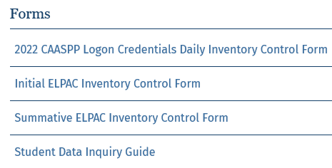
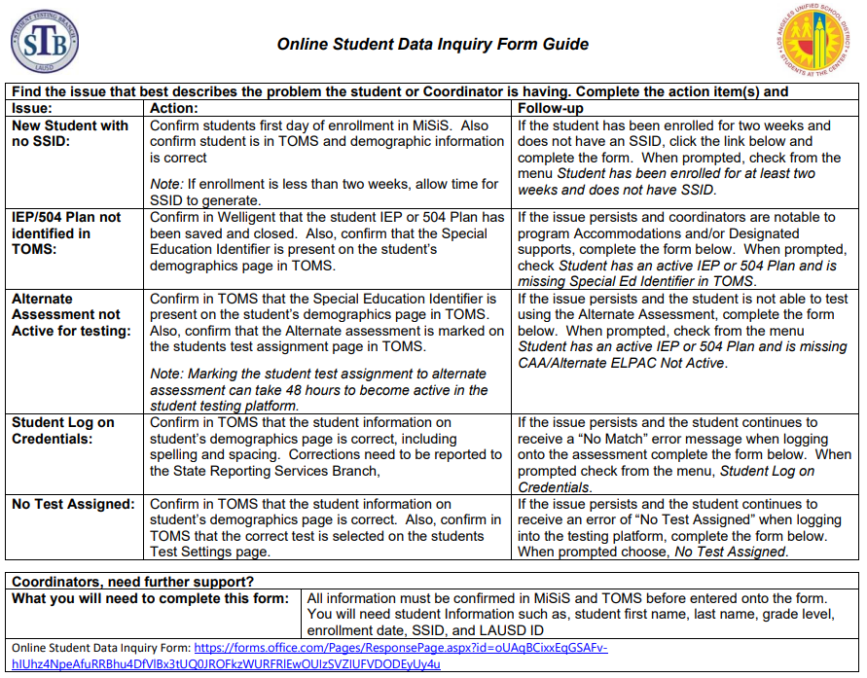
Online Student Data Inquiry Form
Access the Student Data Inquiry Guide in STB’s Coordinator Resources
Find the issue that is occurring.
If you can confirm the related Actions for the issue, click on the link to access the Online TOMS Student Data Inquiry Forms.
Notes:
Coordinators can access the form in Coordinator Resources

Slide 43
Online Student Data Inquiry Form
To complete the Online Student Data Inquiry Form, you will need the following student information
  Student first name
  Student last name
  Grade level
  Enrollment date
  SSID
  LAUSD ID
  All information must be confirmed in MiSiS and TOMS before entered onto the form.
Follow the prompts on the Online Student Data Inquiry Form and enter the required information.
After submitting the online form, you will receive a confirmation email.
An STB staff member will email you with further questions or when the issue is resolved.
Notes:
Coordinators will receive a follow-up email once the issue has been resolved or if it has been escalated

Slide 44
Action Items
Download your school site's Initial ELPAC and Initial Alternate ELPAC Student Eligibility Report after you receive your TOMS account.
Check for an English Language Acquisition Status of TBD on students' TOMS Profile Page.
Verify with your SpEd Team who will take the Initial Alternate ELPAC per the IEP.
Assign the Initial Alternate ELPAC to eligible students.
If a student has been enrolled for 2 weeks or more and does not have a TBD ELAS, contact SRSB at (213) 241-2450.

Slide 45
Before Testing
Training Requirements

Slide 46
Site ELPAC Coordinators
Each school must always have at least one, fully trained ELPAC Coordinator on site or testing cannot begin nor proceed.
  Contact STB and your Region MMAL Team for guidance if there will be a change in ELPAC Coordinator at any point throughout the year.
    Do not wait until the last minute!
  School’s TE accounts will be deleted if there is not a fully-trained ELPAC coordinator on site.
Principals may designate a 2nd ELPAC Coordinator (must complete all Coordinator training requirements) by contacting James Overturf (james.overturf@lausd.net).
  The 2nd coordinator SUPPORTS the primary ELPAC Coordinator and may not have access to all platforms as the primary coordinator.
Notes:
The District requires each school to have one fully trained ELPAC coordinator throughout the year. The ELPAC coordinator will manage and oversee each of these assessments
Initial and Initial Alternate ELPAC
Summative and Summative Alternate ELPAC
If any time throughout the year you move, change assignments, go on leave, your principal will need to designate someone in your absence or to take your place.

Slide 47
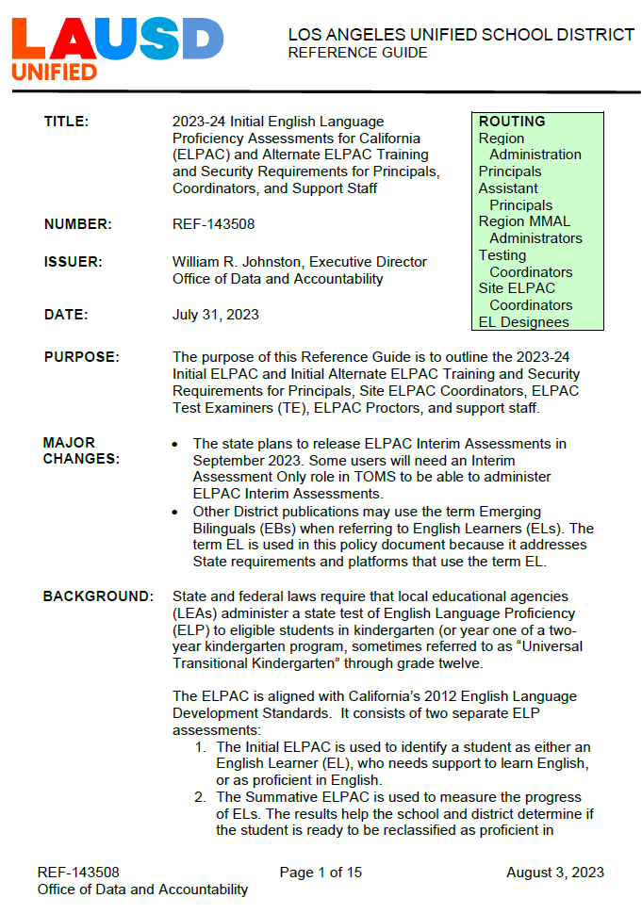
Policy Document
Reference Guide 143508- 2023-24 Initial English Language Proficiency Assessments for California (ELPAC) and Initial Alternate ELPAC Requirements for Principals, Coordinators, and Support Staff
Located in E-Library
Notes:
Reference Guide 143508 outline the 2023-24 Initial ELPAC and Initial Alternate ELPAC requirements for Principals, Site ELPAC Coordinators, Test Examiners (TE), and Proctors.

Slide 48
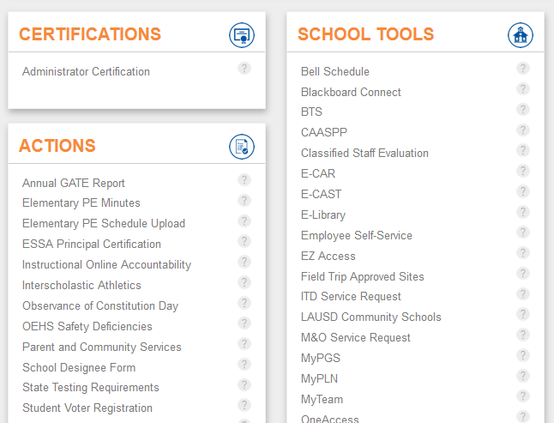
Training Requirements for Principals
Principals complete their requirements in the Principal’s Portal
Electronically certify 2023-24 ELPAC Security Affidavit and Agreement
Designate an ELPAC Coordinator
    Both requirements must be completed prior to the following:
ELPAC Coordinator accessing the Moodle Key.
Delivery of ELPAC K-2 Writing Answer Books.
Notes:
Principals complete 2 training requirements for ELPAC. These requirements must be completed in the Principal's Portal, under the State Testing Requirements link.

Slide 49
Initial ELPAC Coordinator Requirements
2023-24 ELPAC Security Forms Coordinator Requirements (MyPLN) Coordinators are automatically enrolled in the curriculum AFTER being designated as the ELPAC Coordinator in the Principal's Portal. 2023-24 ELPAC Security Forms Coordinator Training 2023-24 ELPAC Security Affidavit and Agreement Complete on LAUSD Network
2023-24 Initial ELPAC and Initial Alternate ELPAC Administration Coordinator Training
2023-24 LAUSD Initial ELPAC Test Examiner Training and Calibration (Moodle) Calibrate for School Span (Speaking AND Writing) e.g., K-5, K-8, K-12 Completed in Moodle, facilitated by MMED and Region MMAL Team https://moodle.caaspp-elpac.org/
2022-23 Summative Alternate ELPAC (2023-24 Initial Alternate ELPAC) Test Examiner Certification (Moodle) Mandatory for any NEW ELPAC Coordinator who did not complete 2022-23 Summative Alternate ELPAC Certification Moodle training last year. This course satisfies the requirement to administer and manage the 2023-24 Initial Alternate ELPAC.
Coordinators can access the Initial ELPAC Moodle keys 1-2 business days AFTER these 2 requirements and the Principal’s requirements are met.
You must have access to your school’s Moodle key to attend this training!
Coordinators will receive their TOMS account and K-2 Writing Books AFTER requirements 1-4 are met.
Notes:
Let's carefully review the Initial ELPAC Coordinator Requirements.
Item 4 is a requirement for any ELPAC Coordinator who did not complete last year’s Alternate ELPAC Examiner’s Certification Course in Moodle during the Summative ELPAC administration. The State will give ELPAC Coordinators and Test Examiners credit for this year’s Initial Alternate ELPAC if they completed that course.

Slide 50

Initial ELPAC Coordinator Requirements
2023-24 ELPAC Security Form Coordinator Requirements
  ELPAC Security Forms Coordinator Training
  Sign Affidavit and Agreement (must be on the Network to sign)
2023-24 Initial ELPAC and Initial Alternate ELPAC Administration Coordinator Training (facilitated by STB)
Initial ELPAC Calibration Moodle Training (facilitated by MMED and MMAL Region Team)
These two trainings can be completed in any order.
2022-23 Summative Alternate ELPAC (2023-24 Initial Alternate ELPAC) Test Examiner Certification
Must be completed if Summative Alternate ELPAC Moodle training was NOT completed last year.
STB creates TOMS account for Coordinator.
Coordinator logs into their ELPAC Coordinator role in TOMS and signs the Affidavit and Agreement.
Coordinator can create Initial ELPAC test sessions.
2-3 hours
Notes:
Keep this flowchart handy for your records.

Slide 51
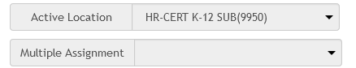
Training Requirements for Teacher Assistants, Paraprofessionals, and Substitute Teachers
The school site administrator will have the option to utilize the following LAUSD employees to assist with the administration of the 2023-24 Initial ELPAC as a Test Examiner (subject to funding restrictions).*
  Trained substitute teachers
  Trained paraprofessionals (may not administer Initial Alternate ELPAC)
  Trained teacher assistants (may not administer Initial Alternate ELPAC)
Individuals must complete all ELPAC Test Examiner (TE) Training Requirements.
Substitutes need to select your school as a multiple assignment when they sign the ELPAC Affidavit.
*Contact your Region MMAL Team if you have any questions regarding funding restrictions.
Student Teachers may not serve as Test Examiners or Proctors.
They may not have access to any ELPAC training or test materials.
Notes:
Any Teacher Assistants, Paraprofessionals, or substitute teachers administering the Initial ELPAC must complete all Test Examiner Training requirements.
It is important for substitutes to select your school in the Multiple Assignment drop down box when signing the ELPAC Affidavit in the STB Portal
Paraprofessionals and Teacher Assistants may not administer the Initial ALT ELPAC
Student teachers cannot have access to any ELPAC assessments or materials

Slide 52
Initial ELPAC Training Reminders
ELPAC Coordinators will use and adapt this presentation to facilitate their school-based training.
Agenda and Sign-In Sheets are provided in the 2023-24 Initial ELPAC Administration Instructions (ATT. D1 and D2)
  This agenda lists all mandated training topics and can be edited to fit site needs.
  Maintain Sign-in sheets and agenda(s) for all Initial ELPAC school-based trainings.
    These will be uploaded to the STB Portal by October 31.
All testing documentation must be maintained on site for 2 years.

Slide 53
Initial ELPAC Test Examiner Requirements
2023-24 ELPAC Security Form TE and Proctor Requirements (MyPLN) 2023-24 ELPAC Security Form Test Examiner and Proctor Training 2023-24 ELPAC Security Affidavit Complete on LAUSD Network Coordinators must designate Initial ELPAC TEs in the STB Portal after completion of both requirements. Moodle accounts will be created by STB for designated TEs who do not have a Moodle account 1-2 business days after designation. | Affidavit is signed in STB Portal via MyPLN. Satisfies the ELPAC Security Requirements for ALL ELPAC assessments for the 2023-24 school year.
2023-24 Initial and Initial Alternate ELPAC Administration School-based Training Use this presentation and add school logistics | Provide Moodle Key(s) to trained TEs after completion of requirements 1-2.
2023-24 LAUSD Initial ELPAC Test Examiner Training and Calibration (Moodle) TEs will calibrate for the grade level(s) they will administer the test Collect Calibration certificate from each Test Examiner One comprehensive certificate for Speaking and Writing per grade | https://moodle.caaspp-elpac.org/ Collect Calibration Certificates
Notes:
Maintain copies of school-based training agenda and sign-in sheets. These will be uploaded to the STB Portal
Maintain copies of Moodle TE Calibration Certificates

Slide 54
Initial ELPAC Test Examiner Requirements
ELPAC Security Form TE and Proctor Requirements (MyPLN)
  ELPAC Security Forms TE and Proctor Training
  Sign Affidavit (must be on the LAUSD Network to sign)
Coordinator designates TE in the STB Portal.
If needed, STB creates a Moodle account.
Moodle account created.
2023-24 Initial ELPAC and Initial Alternate ELPAC Administration School-based Training
  Facilitated by ELPAC Coordinator
1-2 business days
Initial ELPAC Moodle Calibration
  Coordinator provides TE with Moodle key.
Coordinator creates TE TOMS account.
TE logs into their ELPAC TE role in TOMS and signs the affidavit.
TE can create Initial ELPAC test sessions.
2-3 hours
Notes:
Please be sure to inform the individual/s you have created accounts for in advance. As mentioned, they should also be informed that there are two affidavits to sign. Having signed the TOMS affidavit in advance of test administration is key because otherwise they will not see Initial ELPAC as an option in the TA Interface.

Slide 55
Initial Alternate ELPAC TE Requirements
2023-24 ELPAC Security Form TE and Proctor Requirements (MyPLN) 2023-24 ELPAC Security Form Test Examiner and Proctor Training 2023-24 ELPAC Security Affidavit Complete on LAUSD Network Coordinators must designate Initial ELPAC TEs in the STB Portal after completion of both requirements. Moodle accounts will be created by STB for designated TEs who do not have a Moodle account 1-2 business days after designation. | Affidavit is signed in STB Portal via MyPLN. Satisfies the ELPAC Security Requirements for ALL ELPAC assessments for 2023-24.
2023-24 Initial and Initial Alternate ELPAC Administration School-based Training Use this presentation and add school logistics | Provide Moodle Key(s) to trained TEs after completion of requirements 1-2.
2022-23 Summative Alternate ELPAC (2023-24 Initial Alternate ELPAC)Test Examiner Certification (Moodle) This requirement is mandatory for any TE administering the Initial Alternate ELPAC who did not complete 2022-23 Summative Alternate ELPAC Certification Moodle training last year. | https://moodle.caaspp-elpac.org/ Collect Certificates of Completion
Notes:
Initial Alternate ELPAC Test Examiner Requirements are as follows...
Item 3 is a requirement for any TE who did not complete the 2022-23 Alternate ELPAC Examiner’s Certification Course in Moodle last year during the Summative ELPAC administration. The State will give Test Examiners credit for this year’s Initial Alternate ELPAC if they completed that course

Slide 56
Initial ALT ELPAC Test Examiner Requirements
2023-24 ELPAC Security Form TE and Proctor Requirements (MyPLN)
  ELPAC Security Forms TE and Proctor Training
  Sign Affidavit (must be on the Network to sign)
Coordinator designates TE in the STB Portal.
If needed, STB creates a Moodle account.
Moodle account created.
2023-24 Initial ELPAC and Initial Alternate ELPAC Administration School-based Training
  Facilitated by Site ELPAC Coordinator
1-2 business days
2022-23 Summative Alternate ELPAC (2023-24 Initial Alternate ELPAC) Test Examiner Certification
  Coordinator provides TE with Moodle key.
Coordinator creates TE TOMS account.
TE logs into their ELPAC TE role in TOMS and signs the affidavit.
TE can create Initial Alternate ELPAC test sessions.
2-3 hours
Notes:
Please be sure to inform the individual/s you have created accounts for in advance. As mentioned, they should also be informed that there are two affidavits to sign. Having signed the TOMS affidavit in advance of test administration is key because otherwise they will not see Initial ELPAC as an option in the TA Interface.

Slide 57
ELPAC Test Examiner Responsibilities
Complete all required Initial ELPAC trainings and review all policy and test administration documents.
Administer all domains of the Initial ELPAC.
Provide logon credentials to students in a secure manner.
View student information in the Test Administrator Interface prior to testing to ensure that the correct student receives the proper test with the appropriate resources.
Report all potential security incidents to their ELPAC Coordinator.
Perform data and score entry in DEI and THSS.
Notes:
It is the Test Examiner's responsibility to ensure proper test administration using materials, entering scores in the correct systems and reporting any incidents to the school site ELPAC Coordinator. The Test Examiner must do the following:
Complete all required Initial ELPAC trainings and review all policy and test administration documents.
Administer all domains of the Initial ELPAC
Provide logon credentials to students in a secure manner
View student information in the Test Administrator Interface prior to testing to ensure that the correct student receives the proper test with the appropriate resources
Report all potential security incidents to their ELPAC Coordinator
Perform data and score entry in DEI and THSS

Slide 58
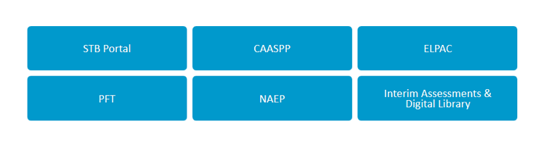
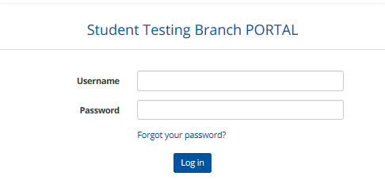
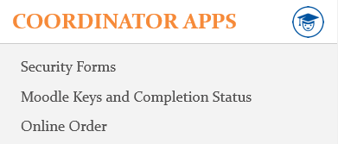
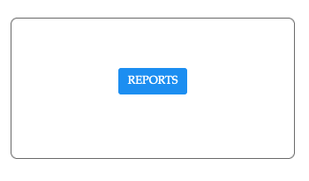
Designating TEs in the STB Portal
Navigate to STB Website: https://www.lausd.org/testing
1
2
3
4
Notes:
To access the Security Affidavit Report from STB Portal, follow steps 1-4.

Slide 59
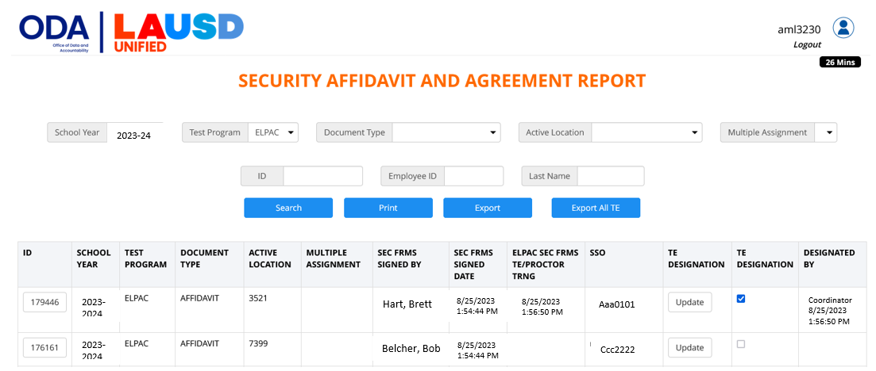

Designating TEs in the STB Portal
2. Select your school to view substitutes.
1. Select Testing Program.
3. Both requirements must be completed in order to designate.
5. Click "Designate (All Selected)"
4. Click the box to designate the individual as an ELPAC TE.
Notes:
The ELPAC Coordinator must designate all ELPAC TEs in the STB before sharing the Moodle key
TEs who require a Moodle account will have one created by STB in 1-2 business days

Slide 60
ELPAC Proctor Requirements
2023-24 ELPAC Security Form TE and Proctor Requirements 2023-24 ELPAC Security Form Test Examiner and Proctor Training 2023-24 ELPAC Security Affidavit | Completed in MyPLN. Affidavit is signed in STB Portal via MyPLN. Non-District BIIs and BIDs must sign a hard copy of the affidavit (located in Coordinator Resources).
2023-24 Initial and Initial Alternate ELPAC Administration School-based Training Use this presentation and add school logistics Review role of Proctors | School-based training, facilitated by Site ELPAC Coordinator. Maintain sign-in sheets and agendas. These will be uploaded to STB Portal.
2023-24 ELPAC Security Form TE and Proctor Requirements (MyPLN)
  ELPAC Security Forms TE and Proctor Training
  Sign Affidavit (must be on the LAUSD Network to sign)
2023-24 Initial ELPAC and Initial Alternate ELPAC Administration School-based Training
  Facilitated by Site ELPAC Coordinator
Notes:
ELPAC Proctor Requirements

Slide 61
ELPAC Proctor Responsibilities
Complete all required Initial ELPAC trainings and review all policy and test administration documents.
Actively monitor students when testing
  Walk up and down the aisles.
  Ensure students are not using unauthorized electronic devices.
Proctors are required when:
  Testing more than 20 students in grades 3-12.
  Testing more than 10 students in 2nd grade Writing.
Proctors do not receive TOMS accounts.
Notes:
The purpose of a trained proctor is to assist with test administration. Proctors do not need a TOMS account, however the proctor must participate all required ELPAC trainings and review policy and test administration documents. During testing, actively monitoring means walking up and down the aisles and ensuring students are not using unauthorized electronic devices. As the ELPAC Coordinator, you should assign a proctor during group administration when tests are administered to groups of 20+ in grades 3-12 and groups of 10+ when administering the grade two writing test.

Slide 62
Action Items
Access Reference Guide 143508 in E-Library (link on STB homepage).
Ensure your Principal completes their Training requirements.
Complete all of the Coordinator training requirements to receive your TOMS Account.
Identify Test Examiners/Proctors who need to be trained.
Meet with your Principal regarding scheduling Initial ELPAC training for staff.
Prepare agenda(s) and sign-in sheets for school-based 2023-24 Initial and Initial Alternate ELPAC Administration School-based Training.
Contact STB and your Region MMAL Team for guidance if there will be a change in ELPAC Coordinator at any point throughout the year.

Slide 63
Before Testing
Moodle Training

Slide 64
Moodle Accounts
A Moodle account is required to access the platform.
  Moodle account is NOT related to TOMS or LAUSD SSO.
  Moodle account is only created ONCE in an individual’s lifetime.
  Previous users will use their existing Moodle account.
STB will create a Moodle account for 1st time users ONLY.
  Coordinators- Account created upon designation in Principal’s Portal.
  TEs- Account created AFTER Coordinator designates them in the STB Portal.
  User will receive an email from moodlesupport@scoe.net
    Save username
No LAUSD employee should create a Moodle account! ALL accounts are managed by STB!
Notes:
The Moodle training platform is used for both the Initial and Alternative ELPAC assessments.

Slide 65
Moodle Enrollment Keys
Moodle enrollment keys allow access to specific ELPAC trainings in the LAUSD section of Moodle.
  Each school has a set of unique Moodle Keys for each ELPAC Assessment:
    Initial ELPAC
    Initial Alternate ELPAC
ELPAC Coordinators will receive access to the Initial ELPAC Moodle Keys in the STB Portal 1-2 business days AFTER both of the following are completed:
  Coordinator is designated in the Principal’s Portal.
  Principal and Coordinator complete Security Requirements.
ELPAC Coordinators will distribute the Moodle Key(s) AFTER designating the TE in the STB Portal.
  The Moodle Team will not provide you with Moodle Keys.
  Contact STB for Moodle key support; DO NOT email Moodle.
  The keys will not work if you are accessing the incorrect course.
Notes:
The Moodle training platform is used for both the Initial and Alternative ELPAC assessments.
Coordinators distribute their school’s Moodle keys to eligible TEs

Slide 66
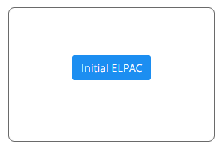
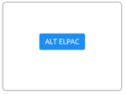
Accessing the Moodle Keys in STB Portal
ELPAC Coordinators will securely distribute the school’s Initial or Initial Alternate ELPAC Moodle enrollment key to individuals who have been designated as TEs in the STB Portal.
Notes:
This is how you will access the Moodle Key from the STB Portal.

Slide 67
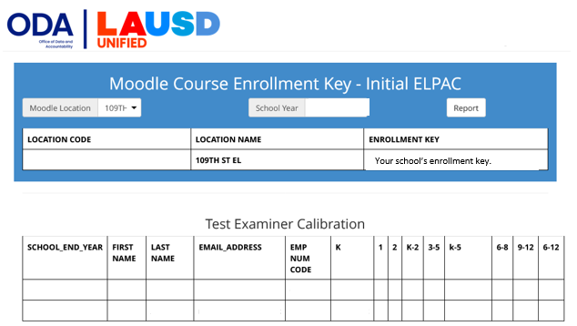
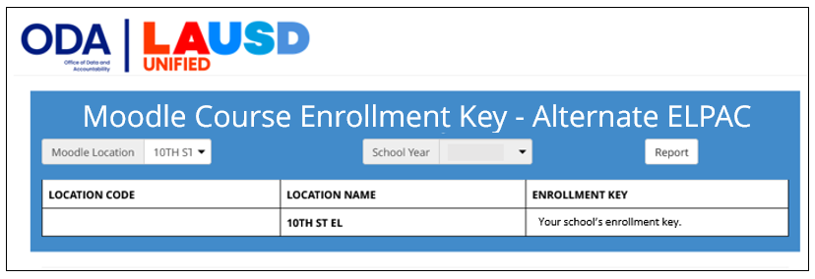
Accessing the Moodle Keys in STB Portal
Moodle keys can be accessed 1-2 business days AFTER the Principal and designated ELPAC Coordinator have completed ELPAC Security Requirements.
Notes:
If the principal or Coordinator have not completed ELPAC Security Requirements or if the coordinator has not been designated in the Principal’s Portal, the Moodle keys will not be available
Only the primary ELPAC Coordinator has access to the Moodle keys.
ELPAC Coordinators will not be able to attend ELPAC Calibration training with their Region EL Coordinators if they cannot access the Moodle key.

Slide 68


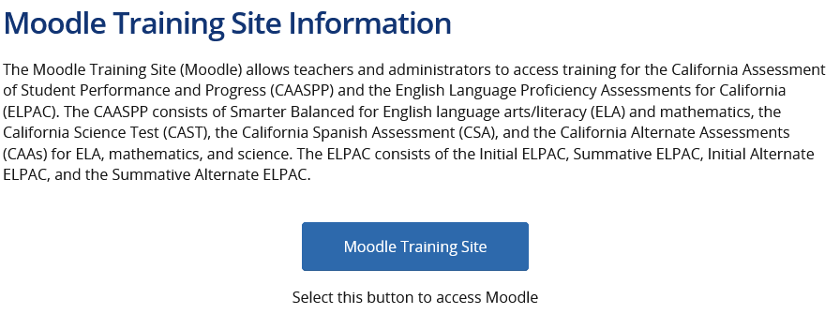
Accessing the Moodle Website
Access the Moodle website 2 ways:
STB homepage (Quick Links)
elpac.org
1
2
Initial ELPAC Moodle Quick Guide

Slide 69
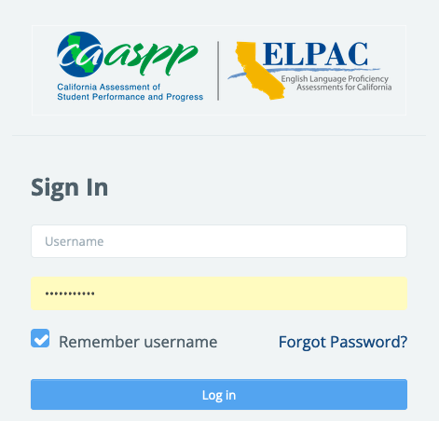
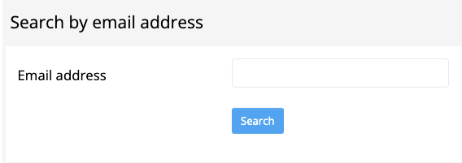
Moodle Access
If your TEs forgot their Moodle username and/or password, direct them to the Moodle website. https://moodle.caaspp-elpac.org
Select Forgot Password
Search by email address ONLY (enter LAUSD email)
An email will be sent from moodlesupport@scoe.net
1
2
If an email is not received, contact moodlesupport@scoe.net for assistance.
Notes:
Provide these instructions to your Test Examiners.

Slide 70
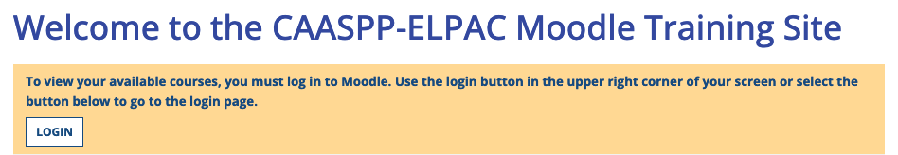

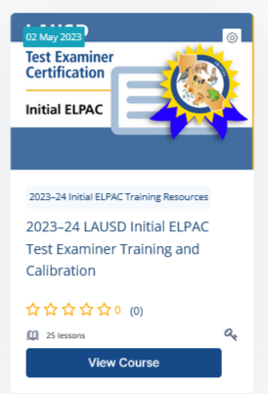
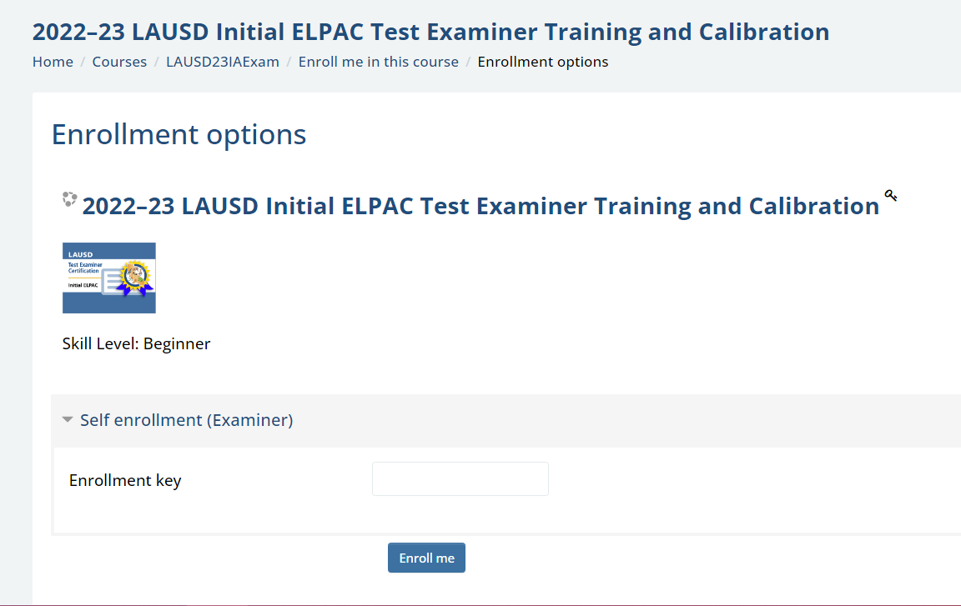
Accessing the Initial ELPAC Moodle Course
Moodle website
  https://moodle.caaspp-elpac.org
Scroll down to the LAUSD Section on the Moodle homepage.
  Select 2023-24 Initial ELPAC Training Resources.
Select 2023-24 LAUSD Initial ELPAC Test Examiner Training and Calibration.
  This course is for TEs and Coordinators.
Enter your school's Initial ELPAC Moodle Enrollment Key when prompted.
Enter the key exactly as it is in the STB Portal.
Notes:
The next set of slides provide instructions for accessing the Initial ELPAC Moodle Courses in the Moodle platform. Share these instructions with your TEs.

Slide 71
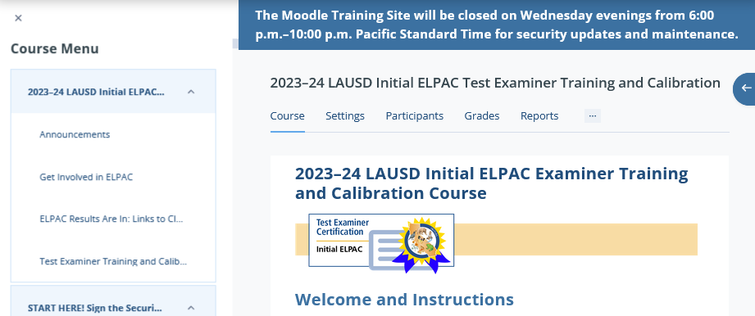

Accessing the Initial ELPAC Moodle Course
DO NOT CLOSE the course menu! This is where you can view your progress.
1. Read the Instructions
2. Sign the Affidavit
3. Watch the Two Mandatory Videos

Slide 72
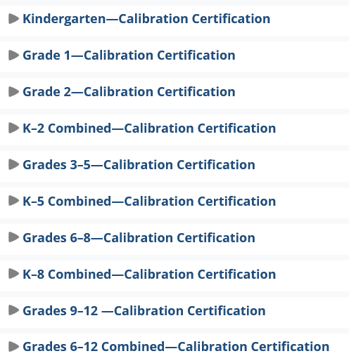
Completing the Initial ELPAC Moodle Course
  4. Complete Appropriate Training for your Role:
  Coordinators complete calibration for the school span (e.g., K-5, K-8, 6-8, K-12).
  Test Examiners complete calibration for the grades they will administer the test.

Slide 73
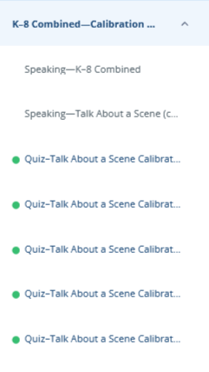
Completing the Initial ELPAC Moodle Course
Keep the COURSE MENU OPEN!
A green dot will appear after you pass each calibration quiz.
Once all calibration quizzes have been completed, click on the Speaking and Writing Certificate of Calibration link and the certificate will be emailed to you.
  Completion will be reflected in the STB Portal Moodle Page in 1-2 business days.
Notes:
Coordinators will collect ELPAC certificates of completion from all TEs

Slide 74
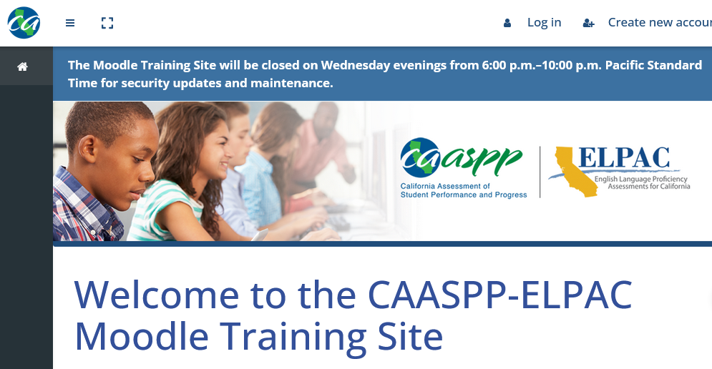
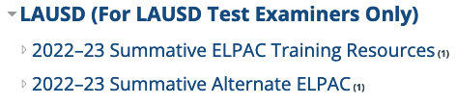
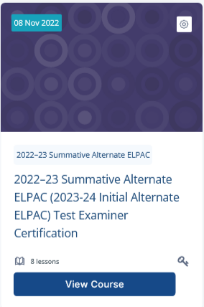
Accessing the Initial Alternate ELPAC Moodle Course
Moodle website
  https://moodle.caaspp-elpac.org
Scroll down to the LAUSD Section on the Moodle homepage.
  Select 2022-23 Summative Alternate ELPAC.
Select 2022-23 Summative Alternate ELPAC (2023-24 Initial Alternate ELPAC) Test Examiner Certification.
Enter your school’s Alternate ELPAC Moodle Enrollment Key when prompted.
Enter the key exactly as it is in the STB Portal.
  This course is for TEs and Coordinators who DID NOT complete the Summative Alternate ELPAC training last year. This training allows TEs and Coordinators to administer the 2023-24 Initial Alternate ELPAC.
Notes:
Reminder! There is a different key for the Initial Alternate ELPAC.

Slide 75
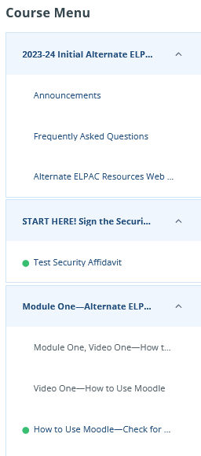
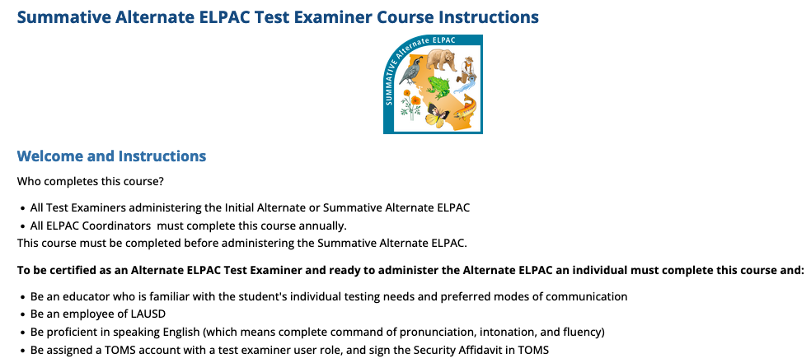

Accessing the Initial Alternate ELPAC Moodle Course
1. Read the Instructions
2. Sign the Affidavit
Keep the COURSE MENU OPEN!
A green dot will appear after you pass each Check for Understanding.

Slide 76


Accessing the Initial Alternate ELPAC Moodle Course
3. View all the videos and pass ALL Check for Understandings in Modules 1-3.
4. Once all Modules have been completed, click on the Certificate of Completion link and the certificate will be emailed to you.
  Completion will be reflected in the STB Portal Moodle Page in 1-2 business days.
Notes:
Coordinators will collect ELPAC certificates of completion from all TEs

Slide 77
Action Items
Share the Moodle key(s) with TEs that have completed 2023-24 ELPAC Security Form TE and Proctor Requirements.
Share the Quick Guide(s) for the Initial ELPAC Moodle training(s) with TEs who have completed 2023-24 ELPAC Security Form TE and Proctor Requirements.
Remember to enroll in the Initial ELPAC courses located in the LAUSD section of the Moodle homepage.

Slide 78
Before Testing
Monitoring Completion of TE Requirements

Slide 79
Monitoring Completion of Security Requirements
Navigate to STB Website: https://www.lausd.org/testing
1
2
3
4
Notes:
Follow steps 1-4 to access the Security Affidavit Report from STB Portal.

Slide 80
Monitoring Completion of TE & Proctor Requirements
2. Select your school to view substitutes.
1. Select Testing Program.
3. Verify completion of both Security Requirements and designation.
4. Proctors are not designated.
Notes:
Process for monitoring completion of TE and Proctor training is the same as last year.

Slide 81
Monitoring Completion of TE & Proctor Requirements
If a site employee is not populating on the Affidavit and Agreement Report, they DID NOT sign the ELPAC Affidavit; they only marked it COMPLETE in MyPLN.
  Guide them to sign the affidavit directly in the STB Portal.
    Log into the STB Portal
    Select SECURITY FORMS
    Select ELPAC
    Read, sign, and click CERTIFY/SUBMIT
    Completion will immediately populate in the STB Portal
If a substitute is not populating on the Report, select your school in the Multiple Assignment dropdown menu.
  If they still do not populate, have them complete the steps listed above and select your school as a multiple assignment.
  If they already signed and are unable to add your school, call STB.
Notes:
Troubleshooting the Affidavit and Agreement Report

Slide 82
Monitoring Completion of Moodle Training
Navigate to STB Website: https://achieve.lausd.net/testing
1
2
3
4

Slide 83
Completion of Initial ELPAC Moodle
Individuals who have completed Moodle Training will be indicated here within 1-2 business day after the TE completed the course.
Notes:
You can access a list of TEs that complete the Moodle training from the STB Portal.

Slide 84

Completion of Initial ALT ELPAC Moodle
Poll
Individuals who completed this training last year or this year will be indicated here.
Notes:
You can access a list of TEs that complete the Moodle training from the STB Portal.

Slide 85
Check for Understanding #2
The ELPAC Coordinator must designate all Test Examiners in the STB Portal and ensure requirements are met before assigning a TOMS account.
True
False
The ELPAC Coordinator must designate each Test Examiner in the STB Portal and verify that all training requirements have been completed before creating a TOMS account. If a TOMS account is created for an untrained individual, it will be deleted by STB.

Slide 86
Action Items
Confirm that TEs have completed ELPAC Requirements in the STB Portal.
Monitor Completion of Moodle training(s) in the STB Portal and collect Moodle Completion Certificates.

Slide 87
Before Testing
ELPAC TOMS Accounts

Slide 88
ELPAC Coordinator TOMS Accounts
ELPAC Coordinator TOMS accounts are created by STB after all Principal and Coordinator training requirements have been completed and verified.
ELPAC Coordinator TOMS accounts allow for the following:
  Administer ELPAC assessments to students
  Create Test Examiner accounts (Do not create a TE account for yourself)
  Create and submit STAIRS
  Enter Designated Supports and Accommodations for students
  Access site-level reports
  Data and score entry in DEI and THSS
  Access Completion Status Portal Reports through elpac.org
  Access assessment results in CERS
Notes:
TOMS accounts are the gateway to test administration and allow access to start tests and secure materials. Therefore, our office has developed a process for identifying who should receive accounts based on their role and within STB we have a number of checks and balances for created ELPAC Coordinator TOMS accounts AFTER all Principal and Coordinator training requirements have been completed and verified. There are several functions allowable with the ELPAC Coordinator TOMS account to support you with management and proper test administration to all eligible students.

Slide 89
ELPAC Test Examiner TOMS Accounts
ELPAC Test Examiner TOMS accounts are created by the school’s ELPAC Coordinator after verifying completion of:
  ELPAC Security Form Training
  ELPAC Affidavit
  Initial ELPAC school-based training
  Moodle calibration(s)
ELPAC TE TOMS accounts allows for the following:
  Administer ELPAC assessments to students
  Data and score entry in DEI and THSS
  Access completion status reports and test results
Notes:
Once, you, the ELPAC Coordinator have met the training requirements and have been issued a TOMS account, one of your duties is to create ELPAC Test Examiner TOMS accounts. Note who can serve as a TE, the specific training requirements and how to monitor completion of the requirements were outlined on previous slides

Slide 90
Security
Staff who are granted TOMS accounts are permitted to access secure and confidential information and resources.
Do not share account credentials with any other employee or person.
Memorize or store account logon information in a secure location; do not request computer to store or remember password.
Do not disclose or share any secure material in any format with anyone else.
Notes:
Note that employees of our district who serve as Test Examiners are required to sign an ELPAC Security Affidavit in STB Portal and when logging into ELPAC TOMS for the first time. The state also has an authentication process set up for TOMS account holders who are logging into TOMS on a different device.

Slide 91

Creating Test Examiner Accounts
Did you verify the completion of requirements in the STB Portal?
Did you designate the individual in the STB Portal?
Do you have the TE’s Moodle calibration certificate(s)?
Did they participate in the school-based training?
If TOMS accounts are created for untrained TEs, STB will delete the accounts.
Notes:
We ask you to please be cautious before logging into to TOMS with your ELPAC Coordinator role and creating accounts. You should first, ask yourself three important question:
Did you verify the completion of requirements in the STB Portal?
Did you designate the individual in the STB Portal?
Do you have the TE’s Moodle calibration certificate(s)?
By doing so, you will prevent unauthorized access to secure materials and ensure that TEs are properly trained to administer tests to students at grade levels for which they were trained.

Slide 92

Creating Test Examiner Accounts
ELPAC Coordinators can add users to TOMS individually or through batch file upload, using a template, to add several users at once.
Batch
”Upload”
Individual
“ADD”
Use only LAUSD Emails
Complete all fields
Next
Notes:
When you are ready to create accounts, you have choices. You can either create the accounts one by one or for several users using the batch file upload template available on the TOMS Users page. This slide calls out the buttons and fields you will need to create the user’s profile prior to adding the role.

Slide 93

Creating Test Examiner Accounts
Select "ELPAC
Test Examiner”
Next
Notes:
This is a screenshot of the next page.

Slide 94

Creating Test Examiner Accounts
Confirm that all information is correct. If the email was entered incorrectly, the TE will not be able to access TOMS.
Save
Notes:
This page is very important as it allows you to save the user profile and assigned role.

Slide 95



Creating Test Examiner Accounts
An email will be sent to the TE with a link to create their password.
The TE will have 30 min. to click the link.
  If the link expires, TEs can receive a new email by selecting Request one now from the TOMS logon screen.
Click here to receive a new email link.
Notes:
Be mindful of when you create accounts for TEs as the link will expire in 30 min.

Slide 96



Signing the TOMS ELPAC Affidavit
AFTER CREATING THEIR PASSWORD, TEs must sign the
TOMS affidavit.
1. Access TOMS via elpac.org
2. Click the ELPAC TE Role and the affidavit will populate.
IMPORTANT!
TEs Sign Multiple Affidavits!
STB Portal
Moodle
TOMS
3. Read the affidavit, sign, and submit.
ELPAC test sessions can be created in 2-3 hours.
Notes:
Please be sure to inform the individual/s you have created accounts for in advance. They will need to be prepared to finalize the creation of the account by completing steps 1-3 on this slide. As mentioned, they should also be informed that there are multiple affidavits to sign. Having signed the TOMS affidavit in advance of test administration is key because otherwise they will not see Initial ELPAC as an option in the TA Interface.

Slide 97


Signing the TOMS ELPAC Affidavit
If the TOMS affidavit has not been signed, Initial ELPAC Assessments will not be visible in the TA Interface and sessions cannot be created.
TEs will NOT be able to administer the Initial ELPAC until 2-3 hours AFTER signing the affidavit in TOMS.
  This can affect your testing schedule!
No Initial ELPAC assessments are available to select!
Coordinators should download the Security Forms and Remote Administration Status Report to see who has/has not signed the TOMS Affidavit.
Notes:
Check the Security Forms and Remote Administration Status Report frequently.

Slide 98

Creating Test Examiner Accounts
Poll
Coordinator creates the TE account in TOMS after verifying the completion of requirements.
TE accesses the link through their email to set up password.
TE logs into their TE role in TOMS and signs the affidavit.
TE can test students.
2-3 hours

Slide 99
Check for Understanding #3
In addition to using our SSO to sign the STB Security Forms, Test Examiners must also log into TOMS and sign an affidavit prior to any test administration.
True
False
After receiving their TOMS account, all TEs must log into TOMS to sign the state's AFFIDAVIT. The TE will not be able to create test sessions until 2-3 hours after the TOMS affidavit is signed.

Slide 100
Action Items
Verify the completion of TE requirements on STB Portal prior to creating TOMS Account.
Review Creating Test Examiner Accounts slides.
Create ELPAC Test Examiner accounts in TOMS.
  Use only LAUSD emails.
  Review the information entered before finalizing and creating the account.
Remind TEs to monitor their LAUSD email for the activation email from ca-assessments@ets.org .
  Check junk/clutter folder.
Download the Security Forms and Remote Administration Status Report in TOMS to identify TEs who need to sign the TOMS ELPAC Affidavit.
  Instruct TEs to sign at least 24 hours prior to testing.

Slide 101
Before Testing
Accessibility Resources

Slide 102

Accessibility Resources
https://www.elpac.org/resources/accessibility-resources/
Notes:
Under the Test Administration tab on the ELPAC website, there is a link to information pertaining accessibility resources
Links to the most recent California Assessment Accountability Resources Matrix and to relevant manuals

Slide 103

LAUSD- Accessibility and Accommodations Guidelines
REF 133914- 2022-23 LAUSD Accessibility and Accommodations Guidelines for English Language Proficiency Assessments for California (ELPAC) and California Assessment of Student Performance and Progress (CAASPP).
Contains Attachment A.
  Used to assign designated supports to students.
Available in Coordinator Resources.
Notes:
The LAUSD policy document provides guidance for schools on the use of accessibility resources including universal tools, designated supports and accommodations for both testing programs, ELPAC and CAASPP. Note that our office will release an updated document once the state has published the new Matrix, expected to be released in January.

Slide 104


California Assessment Accessibility Resource Matrix
This matrix describes all the available accessibility resources for ELPAC
Accessibility resources are features or supports that are part of the assessment.
Accessibility resources allow students to participate in an assessment that results in a fair and accurate estimate of each student’s achievement.
https://www.cde.ca.gov/ta/tg/ca/accessibilityresources.asp
Share with IEP Team members and download a copy for your resources!
Notes:
The California Assessment Accountability Resources Matrix is a document that identifies which accessibility resources are available for both CAASPP and ELPAC assessments

Slide 105


California Assessment Accessibility Resource Matrix
Embedded: The resource is provided as digitally delivered components of the secure browser
Non-embedded: The resource is provided separately from the secure browser and must be provided by the school.
Notes:
The California Assessment Accountability Resources Matrix indicates if the support is embedded or nonembedded, and contains a brief description
”Yes” means that the support is available
Embedded supports are available through the testing platform and nonembedded supports are provided by the school outside of the testing platform

Slide 106
California Assessment Accessibility Resource Matrix
Universal Tools
  Available to all students on the basis of student preference and selection.
    Breaks
    Digital Notepad
    Embedded highlighter
Notes:
Additional paperwork is not required for students to use Universal Tools

Slide 107

California Assessment Accessibility Resource Matrix
Designated Supports
  Available for use by any student for
  whom the need has been indicated by an educator or team of educators (with parent or guardian and student input as appropriate) and are regularly
  used in the classroom.
    Recommended-Pause/Replay the audio
    Enlarged mouse pointer
  Use Attachment A from REF-133914
    Principal needs to sign ATT A before the coordinator enters the designated supports in TOMS.
  A student’s IEP or Section 504
  plan may indicate the need for a designated support.
Notes:
Attachment A is required for students to use Designated Supports
Students with IEPs/504 Plans may have designated supports listed on the IEP, if not, ATT A may be used

Slide 108
California Assessment Accessibility Resource Matrix
Accommodations
  Only for students who have an IEP or Section 504 Plan
  Accommodations are listed on the IEP or Section 504 Plan
    Text to Speech
    ASL
Unlisted Resources
  Are non-embedded supports specified in IEP or Section 504 Plan.
  If the unlisted resource changes the construct of the test, the student will be given the lowest obtainable scale score.
Notes:
Accommodations and Unlisted Resources may only be entered for students who have an IEP or Section 504 Plan indicated in TOMS
The ELPAC Coordinator will enter the accommodations indicated on the IEP or Section 504 Plan in TOMS

Slide 109


California Assessment Accessibility Resource Matrix
Part 4 of the Matrix provides guidance regarding designated supports and accommodations for alternate assessments.
Alternate ELPAC Accessibility and Accommodations Guidelines
  This document provides additional guidance for maximizing accessibility in the Alternate ELPAC.
Notes:
Note that Part 4 of the matrix has an additional section to address supports that are available for Alternate ELPAC through the online testing interface. Some students may need additional supports that are used during daily instruction. Please share the Alternate ELPAC Accessibility Guidelines document with your special education teachers.

Slide 110


Accessibility Resources Demonstration Videos
The following link provides demonstrations of select universal tools, designated supports, and accommodations allowed as part of the ELPAC.
  https://www.elpac.org/training/uaag/
  Beneficial for students, teachers, and IEP teams.
  Available in Spanish.
Start reviewing with teachers now for Summative ELPAC administration!
Notes:
Teachers, SpEd staff, and students will benefit from viewing the demonstration videos.

Slide 111

Professional Development for Staff
Review Matrix and demonstration videos
  Teachers will be prepared for Summative ELPAC
Accessibility Resources Virtual Training Series
  https://www.elpac.org/training/ar-training-series/
  Module A: Matching Accessibility Resources to Students' Needs
  Module B: Using Accessibility Resources in Daily Instruction
Notes:
Start training regarding accessibility resources now to prepare for Summative ELPAC.
The Accessibility Resources Virtual Training Series will help teachers and SpEd staff to see the connection between instruction and accessibility resources.

Slide 112
Action Items
Collaborate with your school's SpEd Team to discuss and review the accessibility resources available for the current school year.​
Familiarize yourself with the California Assessment Accessibility Resource Matrix.​ and share with SpEd Team and TEs.​
Review Accessibility Resources Demonstration videos with TEs.​
Distribute Attachment A to TEs.​
Plan Accessibility Resources PD for TEs.

Slide 113
Before Testing
Entering Supports, Accommodations, and Domain Exemptions

Slide 114
Preparing to Enter Supports & Accommodations
Supports must be entered in TOMS by the ELPAC Coordinator at least 2-3 days before the student logs into a domain.
Collect the designated supports Attachment A.
Obtain the following from Elementary APEIS or Special Education Administrator/Designee for eligible students with existing IEPs:
  Initial ELPAC Section K (New for 2023)
    Indicates Alternate ELPAC for eligible students.
    Indicates required Accessibility Resources listed in IEP.
  FAPE Part 2 Section 4
    Review this section if the Section K Report is not available.
Notes:
With the fact that the supports should be entered at least 2-3 days prior to testing the student. It is imperative that you manage your time to collect the signed attachments and any FAPE Part 2 Section 4 (or Section K) pages from the case carrier or administrator over Special Education.

Slide 115




Data Flow
Student Enrolls!
Student-Level
Information
Student Registration
3-5 days
This process is NOT instantaneous!
Student Can Test!
3-5 days
TBD Status populates
2-3 days
Coordinator Enters Supports
Notes:
Test Examiners need to be aware that changes are not immediately indicated in TOMS. It takes time for information to move through the various student information systems.

Slide 116

Entering Supports and Accommodations
1
Do you have the IEP documentation and Attachments?
2. Enter SSID
3
Notes:
Entering the designated supports and accommodations in TOMS is a task that can only be done by the ELPAC Coordinator. This requires using the documentation (IEP, 504 Plan, designated support attachments) and accessibility guidelines in tandem to enter the supports in TOMS. This screenshot of the student's test settings page calls out the three radio buttons you will use to access the student's profile pages one by one.

Slide 117

Entering Supports and Accommodations
4
5. Test Settings
Notes:
These screenshots outline steps 4 and 5 where you will use the magnifying glass to get to the student's profile page and access the test settings section.

Slide 118


Entering Accommodations
To enter Accommodations, Special Education Indicator must be “YES”
Click to select.
Open the dropdown menu to select.
Notes:
Note that the test settings page will indicate YES that the students is in the special education program. The accommodations section check boxes can only be clicked for students if there is a YES indicator on that page.

Slide 119

Entering Accommodations
Notes:
This is a screenshot of the Accommodations section, there is a section for both non-embedded and embedded resources.

Slide 120


Entering Designated Supports
Don’t forget to click UPDATE or your entries will not be saved!
Notes:
This is a screenshot of the Designated Supports section, there is a section for both non-embedded and embedded resources.

Slide 121

Entering Unlisted Resources
To add any Unlisted Resources, please refer to the slides in the Resources Section of this presentation.
Notes:
Contact STB for support if the student requires unlisted resources. These are nonembedded resources that may change the construct being measured. IEP Teams should make decisions based on the needs of students but note that unlisted resources that do change the construct of what is being tested causes the student to receive the lowest obtainable scale score (LOSS) for the affected domain.

Slide 122

Entering Domain Exemptions
Used when a student’s IEP or Section 504 plan specifies that the student has a disability for which there are no appropriate accommodations for assessment in one or more domains.
1. Search for the student in TOMS and select Test Assignments.
2. Enter the Domain Exemptions
indicated on the IEP.
Domain exemptions must be entered for the domains in which the student cannot test per the IEP or Section 504 Plan.
3. Save
Notes:
There is only one exception to students not being administered an ELPAC domain and that is when a student’s IEP or Section 504 plan specifies that the student has a disability for which there are no appropriate accommodations for assessment in one or more domains. It is important to note that domain exemptions are allowable only if there are no available resources or unlisted resources that provide the student access to THAT domain. You will not be able select two domain exemptions that are part of the same composite score. Selection one domain exemption in a composite score automatically grays out the other domain so you can not select it for exemption.
Oral Language Composite=Listening and Speaking
Written Language Composite=Reading and Writing

Slide 123

Test Settings Report
Download the ELPAC School Level Student Test Settings Report to verify that test settings have been entered.
  TOMS Reports > Site Reports
Notes:
Test Examiners must know what supports and accommodations each student is required to have for testing
Develop a process for sharing this information with your Special Education team

Slide 124
Action Items
Before entering accommodations, confirm that “YES” is indicated on the SpEd flag identifier on the student's demographic page in TOMS.
Enter supports and accommodations based on the most current IEP (FAPE Part 2 Section 4).
Collect the completed Attachment A then enter the designated supports into TOMS.
Generate the ELPAC School Level Student Test Settings Report to verify that test settings have been entered.

Slide 125
Before Testing
Technology

Slide 126
Systems Needed for Initial ELPAC
Test Operations Management System (TOMS)
  The Coordinator confirms student registrations, assigns student test settings, and accesses Student Score Reports (SSRs).
Test Administrator (TA) Interface
  The Test Examiner logs on to the TA Interface to initiate, approve, and monitor student testing.
Secure Browser
  A secure online testing environment in which a device is restricted from accessing prohibited computer applications, copying, or otherwise sharing test data.
  LAUSD managed devices will be updated by ITS
  Access https://ca.portal.cambiumast.com/ to update non LAUSD managed devices school purchased devices (except Chromebooks)
Notes:
There are five important systems you will access to manage and or administer the ELPAC test. These systems are interrelated and share details about the student's profile, test settings.

Slide 127
Systems Needed for Initial ELPAC
Data Entry Interface (DEI)
  Speaking scores are transferred from the Student Score Sheet into the DEI immediately after test is submitted.
  Writing scores for K-2 are entered in this interface immediately after testing the student.
  For more information, refer to the Data Entry Interface training video in Moodle.
Teacher Hand Scoring System (THSS)
  Writing responses for students in grades 3-12 are scored and submitted by the Test Examiner.
Notes:
Once student's are tested, the DEI and THSS systems will be used to enter scores. Note that these two systems are domain and grade level specific. Later in the presentation, I will cover test administration of each domain and there are some very useful slides that specify how scores are recorded for students at specific grade levels.

Slide 128
Technology Needed for Testing
CAASPP and ELPAC Technical Specifications and Configuration Guide for Online Testing Manual
Operating System | Permitted Browsers
iOS | Mobile Secure Browser (current app)
ChromeOS | Ensure you are using the most recent version of Chrome or Firefox.
Windows
Linux
macOS/OSx
Notes:
The state's testing systems are very sensitive to programming and updates and require the use of these specific browsers. It is important that teacher and student devices are checked and updated to ensure that the permitted browsers are available and meet the requirements BEFORE testing.

Slide 129


Operating Systems and Secure Browsers
Secure Browser v16 is now available through the Secure Browsers web page on the ELPAC website. Secure Browser v15 support will expire October 31, 2023.
MacOS​ | iOS​ | Chrome OS​ | Windows​
MacOS 11.6-13 ​ Secure Browser 15.0​ or 15.5 ​ ​ | iOS 15.4+​ Secure Browser v8​ | ChromeOS v102+​ ​ Secure Browser v8​ | Windows 10 21H2​ Secure Browser 15.0​ ​ ​
​ | ​ | ​ | ​
Check ca.portal.cambiumast.com for the latest updates

Slide 130
ITS Support Plan
Testing Issues
Technical Issues
Teachers/students unable to access the test
Test expiration
Potential testing irregularity
Issues with proctoring test
Student Testing Branch Help Desk 213-241-4104
Create Ticket with ITS
  Testing device(s) not working
  Secure Browser not working
  Testing devices losing connectivity
  Need help getting devices ready
URL: css.lausd.net or Call 213-241-5200
To escalate urgent technical device issues, contact your IT Support Supervisor. For other IT related escalations, please contact your IT Liaison.
  IT Points of Contact https://docs.google.com/spreadsheets/d/1az5lLCck5blEj1NqQy4bp7kfhyr1yvtNvTN24dtjBF4/edit#gid=0

Slide 131
Testing Device Requirements
Audio Requirements
  Devices must have built-in speakers or external speakers.
    Sound output must be adjustable.
  One-on-one administrations (K-2 all domains and K-12 Speaking)
    Test Examiner listens along with the student.
  Group administrations (grades 3-12 except Speaking)
    Headphones or headsets are required for students.
Recording Requirements
  Use devices with built-in recording or microphone capabilities.
Once the test session has started, adjusting the audio volume will require the student to logout of the test.
Notes:
The tests include the need for both listening and recording. TEs and students should have access to devices with these specifications.

Slide 132
Technology For Test Administration
TE Device
A computer with a microphone.
  Requires a mouse, touchpad, or touch screen.
  A current version of one of the following web browsers:
    Chrome
    Firefox
Student Device
A computer or tablet with a microphone.
  Requires a mouse, touchpad, or touch screen.
  Tablet must have an external keyboard.
  Secure Browser must be installed on the device.
Notes:
This might be a good slide to share with Test Examiners and students in preparation for testing and useful as a checklist when administering practice tests.

Slide 133
Action Items
Confirm that all student devices have Secure Browser downloaded according to the Supported Secure Browser Versions for Student Testing page.
Ensure TE web browsers (Chrome or Firefox) are updated according to Operating Systems and Permitted Browsers page and type of device being used.
  Clear web cache and cookies.
For further technical support, contact ITS (213) 241-5200.

Slide 134
During Testing
Monitoring Test Completion

Slide 135
ELPAC Website
Completion Status
Monitor test completion status for ELPAC domains
Run Reports several times per week
This portal will provide the most accurate completion reports!
Notes:
As mentioned earlier in the presentation, the ELPAC Website is the gateway to various systems needed to perform your tasks. The landing page provides the radio buttons to access these systems. The Completion Status system is one and accessible here

Slide 136



Plan and Manage Testing Report
1
2
3
Notes:
Follow the steps indicated to access the Plan and Manage Testing Portal

Slide 137

Plan and Manage Testing Report
Your school populates
1. Select Test
2. Select Filters
3. Generate (View) or Export Report
Notes:
Select your test
Apply filters such as:
Students who have completed any opportunity
Students who have not completed any opportunity
Students whose test have expired
Generate or Export the Report to view or export the report

Slide 138

Plan and Manage Testing Report
Check the status of the test.
If the Expiration Date column indicates a date, a STAIRS needs to be completed to REOPEN the test.
Notes:
Run this report frequently to monitor completion status for the school site
If a students test is paused, they must log in and complete the test prior to the test expiring

Slide 139
Plan and Manage Testing Report
Poll
Initial ELPAC |  | Initial Alternate ELPAC
Grades K-2 | Grades 3-12 | All Grades
Speaking Test Speaking Online DEI Reading Test Listening Test Writing Online Data Entry Interface The Writing test will not be indicated because it is not a computer-based test. | Speaking Test Speaking Online DEI Reading Test Listening Test Writing Test The scoring of writing responses in the Teacher Hand Scoring System (THSS) is not reflected here. Coordinators must check the THSS platform. | Initial Alternate ELPAC
Notes:
Note this slide, as it will be helpful when reading the completion status report and making decisions about students or groups of students whose tests may not be complete, including the entry of scores when applicable.

Slide 140
Check for Understanding #4
The best place to access a report to get the most up to date data for students' testing progress, coordinators should get the report from which of the following?
Completion Status Portal
TOMS
The Completion Status Portal is accessed through the ELPAC homepage. It provides the most accurate and up-to-date details regarding test completion.

Slide 141
Action Items
Review the steps for generating the Completion Status from the ELPAC website with TEs.
  Most common reports generated:
    Have not completed an assessment.
    Completed and students in progress.
    Student testing information only for the SSID entered
  Download the Completion Status Reports Quick Guide from Coordinator Resources.

Slide 142
During Testing
Preparing for Test Administration

Slide 143
Student Logon Credentials
Student logon credentials include personally identifiable information (PII), which is secure and is protected by federal privacy laws.
Student’s First Name
  The name must be typed exactly as it appears in TOMS
  TOMS will indicate a Preferred Name if one was entered in MiSiS
Student’s SSID
Notes:
Students require their Student log on credentials, which include the child's first name and Student Statewide Identification number or SSID. This information is private and protected by federal laws. Anyone with access to the PII must have a security affidavit on file and keep the log on credentials secure.

Slide 144

MiSiS Smarter Balanced Label & Student Rosters
3. Complete Fields
1. Reports
Coordinators will use their Categorical Coordinator Role to access labels and rosters. Request access from your Principal through oneAccess.
4. View Report
2. Testing > Student Testing Label/State Testing Roster
Notes:
This information is available in MiSiS. An administrative role approved by your principal will give you access.

Slide 145
MiSiS Student Rosters
ELPAC Coordinators should generate a roster for each teacher administering ELPAC.
  Column B: Preferred Name- Preferred names must be used when reading names out loud and when students log in.
  Columns D and E: Logon Credentials- First Name (Legal or Preferred Name) and SSID
  Column J: Same (*) First Name- A “Y” for any student indicates that there are two or more students with the same first name enrolled in the class
If a student cannot sign-in, verify the data in TOMS
A | B | C | D E |  | F | G | H | I | J
Last Name | Preferred Name (P) | Middle Name | Smarter Balanced Logon Credentials |  | Grade | Teacher | Period | District ID | Same (*) First Name
 |  |  | First Name | SSID
Notes:
The coordinator generates the student roster for each teacher administering tests. If the student cannot log on, check the student’s information on TOMS to verify if it matches the information on the roster. If a student has a preferred name (column B), that name should be used if read out loud. If there is no preferred name, the column will be blank.
Columns D and E are the logon credentials, legal first name and SSID (state). If there is an asterisk by the student’s name in Column J, that means there is another student with the same first name in the class, therefore, teachers must be careful that the correct student’s information is given to the correct student.

Slide 146

MiSiS Labels – Student Logon Credentials
Securely Stored by the Coordinator
TEs sign out/in daily
Logon Credentials:
First Name or Preferred Name
SSID Number
There are two or more students with the same name in the class.
Grade
Period
LAUSD ID #
Teacher Name
Student’s Last Name
Preferred Name:
  If preferred name exists, it is bold, and followed by (P).
  If preferred name does not exist, only last name and Middle Initial are displayed.
Notes:
This slide shows a sample student testing label. It has the student’s logon credentials (first name and SSID) on the top left. Towards the right is an asterisk if another student in the class has the same first name. Below that will be their last name and a preferred name, if any. Underneath that line will be the grade, period, district ID and teacher name.

Slide 147

MiSiS: Labels – Student Logon Credentials
Label Details
30 labels per page
AVERY 5160, MACO 3000 or equivalent
Type: Address Label
  Height: 1”
  Width: 2.63”
Page size: 8.5” x 11”
Smarter Balanced Labels Job Aid
Notes:
The labels to be used have 30 labels per page. Avery 5160, MACO 3000 or an equivalent label can be used. Click on the Smarter Balanced Labels Job Aid for help, if needed.

Slide 148

Initial ELPAC Daily Inventory Control Form
TEs and ELPAC Coordinators will check out/in the following materials each day of testing using the Daily Inventory Control Form:
Student Logon Credentials
DFA (if not using electronic version)
Scratch paper
K-2 Writing Answer Books*
Student Score Sheet for Speaking*
  *Not applicable for Initial Alternate ELPAC
Located in Initial ELPAC Administration Instructions.
Notes:
Daily Inventory Control Forms should be prepared ahead of time and used when checking in/out materials for testing each day. This is also useful to keep track of materials even if you are the only TE for Initial ELPAC. This form is certified by the ELPAC Coordinator and may be requested in an audit or for post test documentation.

Slide 149
Initial ELPAC Preparing for Test Administration (PFA)
The Preparing for Administration (PFA) document is a new nonsecure document and should be used PRIOR to test administration.
  Prepares TEs for test administration and allows them to become familiar with testing guidelines.
  Contains the planning and preparation content previously found in the DFA.
PFAs are posted in the Manuals and Instructions web page on the ELPAC website.
  PFA for K-2
  PFA for grades 3-12
Notes:
The PFA assists TEs with preparing for Initial ELPAC. The PFAs are NOT SECURE.

Slide 150

Accessing Practice and Training Tests
https://www.https://www.elpac.org/resources/online-practice-and-training-test/
Notes:
This slide calls out the ELPAC landing page where the TEs and students may access the practice tests. The radio button takes the user to a page with these three option

Slide 151
Practice and Training Tests
Test Examiners should use Practice Tests with students before administering the test.
Practice navigating through the test (TEs and students).
Identify accessibility supports for individual students.
Identify student technical skills challenges.
  Student may need a Designated Interface Assistant or a Test Navigation Assistant
    https://www.elpac.org/s/pdf/ELPAC--TNA-DIA-Use-Scenarios.2019-20.pdf
Notes:
Prior to testing students, the TEs should have also administered practice tests. The benefit of practice tests is huge! It allows the TE to:
Practice navigating through the test (TEs and students)
Identify accessibility supports for individual students
Identify student technical skills challenges

Slide 152
Initial ELPAC Estimated Testing Times
The Initial ELPAC is an untimed test.
  Students are allowed as much time as they need to complete their responses in each domain.
The test should be administered over the course of several days.
The estimated minutes on the ELPAC website are provided as a basis for planning. https://www.elpac.org/test-administration/ia-estimated-test-time/
  Actual testing times may be longer or shorter
Notes:
For planning purposes, you and the TEs should first know that the Initial ELPAC is an untimed test. That means some students will definitely require more time than others. Estimated times should only be used as a basis for planning and the TE should be prepared to administer the test over several days if needed.

Slide 153
Test Security
Click on the link to review the Initial ELPAC security requirements:
  Tables 1- 4 describe security requirements for the test environment during various stages of testing.
    The test environment refers to all aspects of the testing situation while students are testing.
Prepare the following signage for TEs:
  Testing - Do Not Disturb
  Unauthorized Electronic Devices May Not Be Used At Any Time During the Testing Session
Notes:
Review the tables during your school based-training

Slide 154



Initial ELPAC Directions for Administration (DFAs)
The DFAs for the Initial ELPAC include test day instructions and must be used by the ELPAC TE to administer tests to students.
Download from TOMS > Resources.
Contains test administration scripts.
DFAs are SECURE MATERIALS
  Hard copies must be checked out/in each day of testing.
DFAs must not be emailed nor shared electronically.
Notes:
DFAs are required for administration of the ELPAC test. They are secure, therefore, only available to Test Examiners who have met the requirements and have a TOMS account. They should NEVER be emailed or shared electronically. You may print a copy for the TEs but they must be checked in/out to maintain security.

Slide 155

Initial ELPAC DFAs
Poll
All LAUSD schools will use Form 1
DFAs are organized by grade level
  K-2
    Individual DFAs for each grade level
      Kindergarten
      1st grade
      2nd grade
  3-12
    DFAs by grade span
      3rd -5th
      6th -8th
      9th -12th
DFAs must be used EVERY TIME a domain is administered!
Notes:
Please make note of this slide. It outlines the use of Form 1 for all LAUSD school and the use of DFAs by grade level/span. Again, there is no exception to the use of DFAs. It is a non-negotiable.

Slide 156
Check for Understanding #5
Which document is SECURE and must be checked out/in with the Coordinator if printed?
DFA
PFA
Printed copies of DFA are considered SECURE materials and must be checked out/in from the ELPAC Coordinator each day of testing.

Slide 157
Action Items
Generate and securely store student logon credentials.
  Must have MiSiS role: Categorical Coordinator.
Encourage TE(s) to utilize practice/training tests.
Review PFA.
Prepare K-2 Writing Answer Books.
Prepare rooms for testing and distribute signage.
Download, print, and/or guide TE(s) to the DFA(s).
Prepare Inventory Control Forms for TEs to check out/in testing materials.

Slide 158
During Testing
Creating a Test Session

Slide 159

Creating a Test Session
Test Administrator Interface.
Test Examiners create ELPAC testing sessions and monitor testing.
  A test session is created for all domains except K-2 Writing.
Notes:
To create an OPERATIONAL Test Session, click on the Test Administration interface tab on elpac.org

Slide 160


How To Start an Initial ELPAC Test Session
Printable How to Start an ELPAC Test Session documents are available.
Non-secure
2 versions
  Initial/Summative ELPAC
  Initial/Summative Alternate ELPAC
Notes:
You may want to print and share these documents with TEs during your school site administration training.
This information is no longer in the DFA.

Slide 161

Creating a Test Session
x
Start a NEW Test Session that students will immediately join.
Do NOT preschedule sessions.
Do not pre-preschedule sessions.
Click here to start a NEW test session.
Notes:
DO NOT create Test Sessions ahead of time. We are administering tests in person, in the moment and there is no need to schedule a session and generate a session ID.

Slide 162

Creating a Test Session
TE’s name indicated here.
Session ID
Select Test
Notes:
Note the colors for the Initial ELPAC and the Initial Alternate ELPAC assessments
Click the assessment you wish to administer
Note the session ID is now generated on this page

Slide 163

Creating an Initial ELPAC Test Session
TE’s name indicated here
2. Verify the tests you selected.
1. Select the grade level and domains you will administer during the test session.
3. DO NOT change.
4. Click “Start Operational Session.”
Notes:
Select the grade level of the test(s) you wish to administer
Select the domain
Verify that you selected the correct tests
Click "Start Operational Session"
In-person is the default session type

Slide 164

Creating an Initial Alternate ELPAC Test Session
TE’s name indicated here
2. Verify the tests you selected.
1. Select the grade level test you will administer.
3. Initial ALT ELPAC is only administered IN-PERSON.
4. Click “Start Operational Session.”
Notes:
For Initial Alternate Assessments, select the grade level or span of the test you wish to administer
Verify that you selected the correct tests
Click "Start Operational Session"
In-person is the default session type

Slide 165
Session ID
After starting the operational session, write down the generated Session ID Number and share with students in grades 3-12 who are taking Initial ELPAC domains (except Speaking).
  Write the Session ID on the board so it is visible to students.
TEs should document all Session IDs for their records.
Notes:
Writing the session ID on the board will allow students to easily rejoin the session in case their test is paused or they lose connectivity.

Slide 166



Log in to Test Session Using Secure Browser
Who logs into the Secure Browser?
Initial ELPAC
  TEs log into all domains for K-2 students and the Speaking domain for students in grades 3-12.
  Students in grades 3-12 log in for themselves except for Speaking domain.
Initial Alternate ELPAC
  TEs log in for all students.
Chromebooks:
Access Secure Browser BEFORE logging into Chromebook​
Click on “Apps”​
Select “Secure Test Browser”​
Windows/Mac
iPad
Notes:
This slide shows how to access the secure browser using different devices.
Note: When using a Chromebook, the secure browser will be accessed BEFORE logging into the Chromebook.

Slide 167
Creating a Test Session
When creating a test session, select only the domains you plan to administer to the student during that session.
  Students in grades 3-12 should not be given the Speaking test as an option to select since they DO NOT navigate it for themselves.
  Student or TE will have to log off the test session after each domain, however, they can log into the next domain using the same test session ID.
There are no domains for the Initial Alternate ELPAC.
Notes:
Reminder- Students do not log in to nor navigate the Speaking domain
To avoid issues, do not select the speaking domain with any other domains when creating sessions

Slide 168

Signing Into a Test Session
Information needed to log into a Test Session
First Name as it appears in TOMS
  Student may have a Preferred Name
SSID
Session ID
Coordinator must verify that the student is on the TOMS Initial ELPAC eligibility report before attempting to assess.
Notes:
Verify that students have an SSID and are assigned the correct ELPAC assessment in TOMS BEFORE starting testing

Slide 169
Signing Into a Test Session
TEs are only allowed to log in for a student when the student is physically present and ready to begin testing.
  VERIFY that the correct SSID is being used to log in for the student!
Do not log in using a student’s credentials unless administering a domain that requires the TE to do so.
  K-2 domains
  K-12 Speaking
  Initial Alternate ELPAC
  Student has been assigned the Designated Interface Assistant
Notes:
For assessments where the TE navigates for the student, TEs are only allowed to log in for a student when the student is physically present and ready to begin testing.

Slide 170

Logon to Test Session
If all information on the Is This You? screen is correct, select the [Yes] button.
Choose the test on the Your Tests screen.
Notes:
If there are NO TESTS AVAILABLE
Verify student eligibility in TOMS
If the student just became eligible, it may take another day for the system to sync

Slide 171


Logon to Test Session
A student request is sent to the TA Interface and the student is taken to the Waiting for Approval screen.
  TE must verify that the student selected the correct test.
  TE must verify that the student’s Test Settings are correct by selecting the eyeball icon.
Student’s Screen
TE’s Screen
Verify Test
Verify Test Settings
Notes:
TEs must verify that students are logging into the correct test
TEs must verify that students have any required accommodations or designated supports assigned by clicking on the eyeball icon

Slide 172

Logon to Test Session
Verify that the designated supports and accommodations are correct.
If settings are correct, click the green checkmark to approve the student.
If test settings are not correct, do not allow the student to test (click the red X).
Notes:
TEs must verify that students are logging into the correct domain, if not, the student should not be allowed into the test session.

Slide 173

Logon to Test Session
Once the teacher gives approval, the Instructions and Help screen appears.
  Select the [Begin Test Now] button.
  TEs will monitor progress
    TA Interface
    Walking around the testing room

Slide 174



Logon to Test Session
Depending on the domain being administered and/or the student’s assigned accessibility resources, the following checks will be completed:
Audio/Video Check
Text-to-Speech Sound Check
Audio Video and Recording Device Check

Slide 175
Action Items
Download the Security Forms and Remote Administration Status Report to confirm that TE(s) have signed the TOMS affidavit.
Verify that students have an ELAS of TBD in TOMS on their student profiles before beginning a test session.
Remind TEs to check the eyeball icon to verify accommodations and designated supports have been made available before approving students into the test session.

Slide 176
During Testing
Test Administration

Slide 177

Pause Rules - Listening and Reading Only
When can a test be paused?
If the student does not finish the assessment by the end of the testing session
If the student needs a break
Test inactivity
Technical issues such as a power outage
A student’s camera is not working (Remote Administration only)
https://www.caaspp.org/rsc/pdfs/CAASPP-ELPAC-Pause-Rules.pdf
Notes:
TEs should remind students of the pause rules

Slide 178
Test Expiration
Once a test opportunity expires, the student cannot complete nor review the test unless a Re-open Appeal is submitted through STAIRS by the site ELPAC Coordinator.
The state will eventually score the Initial ELPAC, but the results may not be accurate if any domain(s) expired.
Initial ELPAC | Initial Alternate ELPAC
A domain will expire 30 calendar days after the student first logs on to the domain. | Will expire 30 calendar days after the student first logs on to the test.
Notes:
Run your Plan and Manage Testing Reports several times per week to check for paused or expired tests.

Slide 179

Student Score Sheets for K-2
K-2 Writing and Speaking scores must be documented on the Student Score Sheet by ALL TEs.
  DO NOT simultaneously enter the scores into the DEI while testing students.
The Student Information section must be completed.
    Located in the Writing Answer Book!
Notes:
Securely store Student Score Sheets until 2023 SUMMATIVE ELPAC results are in

Slide 180

Student Score Sheets for Grades 3-12
Grades 3-12 Speaking scores must be documented on the Student Score Sheet for EVERY STUDENT.
  DO NOT simultaneously enter the scores into the DEI while testing students.
All student information must be completed, including the date the scores were entered in the DEI.
The ELPAC Coordinator must securely store Student Score Sheets until the student receives Summative ELPAC scores.
    3-12 Score Sheets are in the DFA!
Notes:
Securely store Student Score Sheets until 2023 SUMMATIVE ELPAC results are in

Slide 181

Stopping Markers
Follow instructions in the DFA!
Used in the following situations:
  When the student has not provided any responses up to the stopping marker.
  When the student has not provided any correct responses up to the stopping marker.

Slide 182
Scratch Paper
A student can use blank scratch paper to make notes, record responses, or create graphic organizers.
Only plain paper or lined paper is appropriate for ELPAC.
A student can use a whiteboard with marker.
Scratch paper is to be immediately destroyed after each test session if the student's test will be paused more than 20 minutes.

Slide 183


Test Administration Reminder
Test Examiners use 2 Devices for the following administrations:
  K-2: Reading/Listening/Speaking
  3-12: Speaking
Device 1
TE logs into TA Interface to create test session.
Device 2
TE logs into the Secure Browser to navigate the test for the student.

Slide 184
Action Items
Print out Pause Rules for TE(s).
Make sure TEs use DFAs for every administration.
  Provide hard copies if needed (must be checked out/in each day of testing)
Remind TEs to adhere to the Stopping Marker Guidance in the DFA when applicable.
Provide Student Score Sheets to TEs for Grades 3-12 Speaking.

Slide 185
During Testing
K-2 Reading and Listening

Slide 186
K-2 Reading and Listening
K-2 Administration (Individual Administration)
Grade | Domain | Test Examiner Use In-Person DFA | Student
K-2 | Reading Listening | TE creates an In-Person session in the TA Interface on one device. TE logs into the SECURE BROWSER for the student on another device. TE administers the test using the DFA. TE navigates the test for the student and enters responses. | Student views Test Examiner’s screen. Student provides responses.

Slide 187

K-2 Listening
Follow the DFA instructions when administering
4. Next
2. Play Question
1. Play Stimulus
3. Select the student’s response

Slide 188

K-2 Reading
2. Next
1. Enter student’s response

Slide 189
During Testing
K-2 Writing

Slide 190
K-2 Writing Domain
K-2 Administration (Individual Administration)
Grade | Domain | Test Examiner Use In-Person DFA | Student
K-2 | Writing | TE must ensure they distribute the correct Writing Answer Book to the student. TE administers the test using the DFA and monitors student. TE scores responses and documents on Student Score Sheet (in Writing Answer Book). TE enters Writing scores in the DEI immediately after testing. | Student writes responses directly in Writing Answer Book.

Slide 191
K-2 Writing
Scores must be transferred from the Student Score Sheet and entered in the DEI immediately after testing each student.
  Coordinators must verify in the Completion Status Portal that K-2 Writing scores were entered in the DEI.
Use one browser for administering the test and a different browser for entering scores in the DEI.
RSVP Schools!
ELPAC Coordinator MUST ensure that Initial ELPAC K-2 scores are entered/submitted in the DEI before returning materials to the Testing Center.
Notes:
TEs must enter scores immediately after testing the student

Slide 192
During Testing
K-12 Speaking

Slide 193
K-12 Speaking
K-12 Administration (Individual Administration)
Grade | Domain | Test Examiner Use In-Person DFA | Student
K-12 | Speaking | TE creates an In-Person test session in the TA Interface. TE logs into the SECURE BROWSER for the student on another device. TE administers the test using the DFA TE records prompt and the student’s responses. TE scores in the moment and documents scores on Student Score Sheet. TE enters Speaking scores in the DEI immediately after testing. | Student views TE’s screen. Student provides responses.
The student DOES NOT log in or navigate through the test for the SPEAKING Domain!

Slide 194
Voice Capture (Recording) Requirements
TE will activate the record button before reading each prompt when administering the Speaking domain.
  10% of responses will be scored by Educational Testing Service for federal accountability purposes.
  The score provided by the TE remains as the final score for the student.
Administer Speaking domain in quiet environment where outside sounds are minimized.

Slide 195
Voice Capture Requirements
If the Test Examiner has difficulty recording due to technology, they may proceed with testing the student without recording.
  Contact ITS for support before testing another student.
Listen and score the student’s entire response in the moment.
Test Examiner does not play the recorded responses.
A student’s response should not be re-recorded.
Notes:
The recorded responses are NOT for TE use

Slide 196

K-12 Speaking
Next
Record
TE will record each question as well as the student’s response.
TE uses the rubric to score the student’s response and bubbles the score on Student Score Sheet.
Notes:
The DFA tells you when to click the record button

Slide 197
K-12 Speaking
Scores must be transferred from Student Score Sheet and entered in the DEI immediately after testing the student.
  Coordinators must verify in the Completion Status platform that K-12 Speaking scores were entered in the DEI.
Use one browser for administering the test and a different browser for entering scores in the DEI.
RSVP Schools!
ELPAC Coordinator MUST ensure that Initial ELPAC K-2 scores are entered/submitted in the DEI before returning materials to the Testing Center.
Notes:
TEs must enter scores immediately after testing the student
Coordinators must use the Plan and Mange Testing Report to verify that scores were submitted

Slide 198
During Testing
Grades 3-12 Reading, Listening, and Writing

Slide 199
3-12 Reading, Listening, and Writing
3-12 Administration (Individual Administration or up to 20 Students)
Grade | Domain | Test Examiner Use DFA | Student
3-12 | Reading Listening Writing | TE creates an In-Person test session in the TA Interface using the DFA. TE monitors using TA Interface. Writing Only TE scores student’s WRITING responses in the Teacher Hand Scoring System (THSS). | Student logs into SECURE BROWSER Need SSID Need Session ID Students enter responses independently unless they have the designated support of Designated Interface Assistant (DIA).

Slide 200
During Testing
DEI and THSS- Entering Scores for Initial ELPAC*
*Not Applicable for Initial Alternate ELPAC

Slide 201
How Are Initial ELPAC Domains Scored?
Grade | Domain | Who Enters Responses? | How is Domain Scored?
K-12 | Speaking | TE enters responses for the student. | TE scores in the moment TE documents scores on Student Score Sheet in Writing Book TE enters scores into the Data Entry Interface (DEI)
K-2 | Writing | Students write responses in Writing Answer Book. | TE scores the responses and documents scores on the Student Score Sheet in Writing Book. TE enters scores into the DEI
3-12 |  | Students enter responses individually and independently. | TE scores student’s responses in the Teacher Hand Scoring System (THSS). TE marks scores complete in the THSS.
K-2 | Reading/ Listening | TE enters responses for the student | The Test Delivery System scores the responses.
3-12 |  | Students enter responses independently
Notes:
TEs are responsible for scoring the Speaking and Writing domains only
The Initial Alternate ELPAC does not need to be scored by TEs

Slide 202


Data Entry Interface (DEI)
Enter scores for Speaking Domain (K-12)
Enter scores for Writing Domain (K-2)
Scores are transferred from Student Score Sheets
1
2
3
DEI Instructional video is included in the Moodle training.
Notes:
DEI training video is located in the Moodle Calibration course
Although the training video states that TEs can enter scores into the DEI at the same time they are testing students, this is NOT LAUSD policy. LAUSD policy requires that TEs document the scores on the Student Score Sheet and then enter the scores into the DEI.

Slide 203
Data Entry Interface (DEI)
Enter student information into DEI platform
  First name
  SSID
Sign In
1
2
The DEI screen looks similar to the Student logon screen except it doesn’t have a field for the session ID.
It is recommended to use a different browser when accessing the DEI.
3

Slide 204



Data Entry Interface (DEI)
Refer to student score sheet and select the matching score (“Score 0,” “Score 1,” etc.) in the DEI for each item.
Notes:
K-2 Writing Answer books must have all student information filled out

Slide 205


Entering Scores in the DEI
If a Stopping Marker Rule was used for Speaking as indicated in the DFA:
  Enter scores up to the Stopping Marker
  For the remaining questions, no more score entry is necessary at this point. Select the [End Test] button at the top of the screen in the DEI.
If a Stopping Marker Rule was used for Writing as indicated in the DFA:
  Enter scores up to the Stopping Marker
  No more score entry is necessary at this point. Select the [Next] button at the top of the screen in the DEI until the last question
  Select [End Test] at the top of the screen in the DEI.
Notes:
You may want to provide this slide to your TEs as a reference

Slide 206

Data Entry Interface (DEI)
An orange triangle indicates that the TE forgot to enter a score
  Go back to that item to enter the score from the Student Score Sheet
A STAIRS will need to be submitted in TOMS to report any DEI/Speaking test errors.
Notes:
After clicking SUBMIT TEST, wait for the screen to show the submission verification

Slide 207
Teacher Hand Scoring System (THSS)
The TE who administered the grades 3-12 Writing test will have access to the student’s responses in the THSS.
  ELPAC Coordinators can reassign the responses to themselves or to another TE for scoring.
2-step process
  Score the responses
    Questions for which the student did not enter responses for will not be reflected in the THSS.
  Submit the scores
    Score Reports will not be generated until items in the THSS are scored.
Notes:
Coordinators must check the THSS frequently to identify TEs who have unscored items

Slide 208
Teacher Hand Scoring System (THSS)
View students’ responses
Enter scores for Writing Domain (grades 3-12 only)
1
2
3
THSS Instructional video is included in the calibration training.
Notes:
THSS training video is located in the Moodle Calibration course

Slide 209

Teacher Hand Scoring System (THSS)
The THSS has been upgraded!
Coordinators and TEs must score the Initial ELPAC items.
Notes:
Coordinators must check the THSS frequently to identify TEs who have unscored items
Score Reports will not be generated until all items have been scored and all domains completed.
Ensure your TEs are scoring INITIAL ELPAC Items as Interim Assessment items that require scoring are also housed here

Slide 210

Teacher Hand Scoring System (THSS)
  If “Score” is grey, the item must be reassigned to you in order to complete scoring.
  Select “Score” to begin scoring.
Notes:
Click the hyperlinked SCORE to strat scoring

Slide 211


Teacher Hand Scoring System (THSS)
Click the pencil to assign the score.
Select the score.
Click SAVE.
1
2
3
Notes:
Rubrics are available in the THSS

Slide 212


Teacher Hand Scoring System (THSS)
  1. After scoring all items, check the box to the left of the items you scored.
  2. Click Submit Score(s). Items will be removed from the THSS.
Notes:
After the item has been scored, click the checkbox and then SUBMIT the score.

Slide 213
Action Items
        Ensure that all Writing for grades 3-12 have been scored and submitted into the THSS.
        Ensure that all Writing scores for grades K-2 have been entered into the DEI immediately after testing.
        Ensure that all Speaking scores for grades K-12 have been entered into the DEI immediately after testing.
        Review training videos in Moodle.

Slide 214
During Testing
Initial Alternate ELPAC Tests Administration

Slide 215
Initial Alternate ELPAC Test Administration
The Initial Alternate ELPAC is always administered one-on-one and in-person.
  Administered by a test examiner who is very familiar with the student and their primary communication modes.
  Administered on a computer or similar device using the secure browser.
  Students will not be expected to interact directly with the computer.
    The one-on-one administration model will allow for the TEs to interact with the computer on behalf of a student.
Initial Alternate ELPAC Online Test Administration Manual
  https://ca-toms-help.ets.org/initial-alt-elpac-otam/overview/test-overview/
Notes:
We will now review some of the test administration details as they pertain specifically to the Alternate ELPAC.
Note that due to some of the unique qualities of the students who qualify to take this assessment, it is very important that the selection of Test Examiners are trained LAUSD employees who are most familiar with the student and know their primary communication modes.
There are places within the test that allow for individualization, the interaction with the computer.

Slide 216

Initial Alternate ELPAC Estimated Testing Times
The Initial Alternate ELPAC is an untimed test.
  Students should be given as much time as possible to engage with the test.
  https://www.elpac.org/test-administration/alternate/alt-elpac-estimated-test-time/
The estimated cumulative testing time for the Initial Alternate ELPAC is 45–60 minutes.
Notes:
Please review the estimated testing times
Actual testing times may be longer or shorter

Slide 217

Preparing for Initial Alternate ELPAC Administration
Preparing for Administration (PFA)
  Nonsecure document
  Available on the Manuals and Instructions page on elpac.org
    https://www.elpac.org/s/pdf/Initial-Alt-ELPAC-PFA.2023-24.pdf
  PFA must be used to prepare for test administration.
Notes:
The PFA must be reviewed prior to administering the test
It contains information to help TEs prepare

Slide 218


Initial Alternate ELPAC DFAs
Available in TOMS > Resources
Include test day instructions and the test administration script.
Must be used by the ELPAC TE to administer tests to students.
PRINTED DFAs are SECURE MATERIALS and must be checked out/in each day of testing!
Notes:
DFAs are secure materials
Printed copies must be checked out/in with the coordinator each day of testing

Slide 219


Optional Individualization
Test questions may be individualized based on the student’s IEP.
  Notated as “IND” within the DFA.
  Allows an opportunity to provide real objects, manipulatives, and picture cards as appropriate.
Picture cards are in TOMS > Resources.
  Secure Material
  Two-sided printing is recommended.
  If you are unable to print double-sided, attach the front and back of each picture card together.
Notes:
Some students may require test questions to be individualized
TEs may use Initial ELPAC picture cards or objects stated in the DFA
Picture cards are considered secure materials

Slide 220
Initial Alternate ELPAC Administration
K-12 Administration (Individual Administration)
Grade | Test Examiner Must use DFA from TOMS | Student
K-12 | TE creates an In-Person session in the TA Interface on one device. TE logs into the SECURE BROWSER for the student on another device. TE administers the test using the DFA (Picture Cards may be needed). TE navigates the test for the student and enters responses. | Student views Test Examiner’s screen. Student provides responses.
The TE does not need to complete any additional scoring for Initial Alternate ELPAC.

Slide 221
Initial Alternate ELPAC Stopping Policy
The overarching goal of test administration is to give the student every chance to demonstrate their English language proficiency.
  Stopping and returning is acceptable.
  Stopping and submitting the test before completion should be a last resort.
Notes:
There is a Stopping Policy for the Alternate ELPAC.
As educators, the overarching goal is that we allow students to demonstrate their English proficiency, however, TEs should note that stopping is perfectly acceptable but should be the last resort.

Slide 222
Action Items
Provide hard copies of the Initial Alternate ELPAC DFAs to TEs if necessary.
Review PFA
Provide picture cards if necessary.
Ensure test is administered one-on-one and in-person.

Slide 223
During Testing
STAIRS

Slide 224
Test Security Incidents
Test security incidents are behaviors prohibited because they give a student an unfair advantage or because they compromise the secure administration of the assessments.
Whether intentional or by accident, failure to comply with security and administration rules, either by staff or students, constitutes a test security incident.
Each TE and Proctor must immediately report any testing irregularity to the site ELPAC Coordinator.
All testing incidents need to be immediately reported in the Security and Test Administration Incident Reporting System (STAIRS) in TOMS by the site ELPAC Coordinator.
  Security Breaches must also be reported to STB immediately after the STAIRS is filed.
Some incidents may require that an Appeal be submitted to reset, reopen, or restore.
After the STAIRS is submitted, a confirmation email will be sent indicating if any further action is needed.
Notes:
Call STB for support

Slide 225
Examples of Test Security Incidents
Expired or accidentally submitted tests.
Student was administered the incorrect assessment.
Student took the test using another student’s SSID.
Student took the test using a duplicate SSID.
Social media discussion/posting of secure materials (Security Breach).
Secure test materials were discussed, retained or copied (Security Breach).
Notes:
Call STB for support

Slide 226

STAIRS
ELPAC Coordinators gather information regarding the incident including:
  Date of incident
  SSIDs of student(s) involved
Security breaches must be entered in TOMS immediately by the Coordinator.
Call STB to report any security breach after completing the STAIRS.
Notes:
All testing incidents must be reported in STAIRS
Any security breach must be reported in STAIRS and to STB directly

Slide 227

Creating a STAIRS Report
If a Reset, Reopen, or Restore is required, ensure that it is indicated in the Appeal type section before submitting.
  A 200-character description of the issue and steps to avoid the incident from occurring again, may be required prior to submitting.
Notes:
Call STB for support

Slide 228

STAIRS
If your STAIRS is rejected
Select “Search STAIRS” and enter the STAIRS ID
Review and follow the instructions in the Notes section
Submit a new STAIRS
Notes:
Review the comments from the person who processed your STAIRS
Resubmit the STAIRS following the guidance in the Notes

Slide 229
Action Items
      If you have any questions, contact STB prior to submitting STAIRS.
      Be sure to have student(s) SSID number(s) when creating a STAIRS.
      Be sure to follow-up on all STAIRS submitted.

Slide 230
After Testing
Returning K-2 Writing Materials

Slide 231
ELPAC Pre-ID Labels for RSVP Schools
Only RSVP schools will return Initial ELPAC K-2 Writing Books to STB on November 15-16.
RSVP schools will receive pre-ID labels for the Initial ELPAC K-2 Writing Answer Books for K-2 students who meet the following criteria by October 31, 2023:
  Completed all four domains
  Speaking and Writing scores entered in DEI
Schools will only use state-generated labels provided by STB.
  DO NOT create your own labels.
Directions for applying labels and completing K-2 Writing Answer Book demographic information will be provided along with the labels.
Notes:
Verify if your school has been selected as an RSVP school.
Coordinators must ensure that students have completed all domains and that scores have been entered in the DEI by October 31 or labels won't be generated.
RSVP schools will receive correspondence directly from STB

Slide 232
Return of K-2 Writing Answer Books
RSVP Schools | Non-RSVP Schools
K-2 students tested from August 14- October 31, 2023 Turn-in completed and scored K-2 Writing Answer Books to the assigned testing center on November 15-16, 2023 K-2 students tested from November 1- the last day of school Securely store all completed and unused K-2 Writing Books until the June 3-4, 2024, turn-in. | K-2 students tested from throughout the year Securely store all completed and unused K-2 Writing Books until the June 3-4, 2024, turn-in.
Guidance will be provided in May 2024 regarding the collection of all Initial and Summative ELPAC materials for ALL schools.
Notes:
Do not drop off materials to anyone other than STB personnel

Slide 233
After Testing
Score Reporting

Slide 234

Student Score Reports
ELPAC Coordinators can access ELPAC School-Level Student Score Report PDFs in TOMS under the Site Reports tab.
  Available 24 hours after all domains and DEI/THSS scores have been submitted.
  Available in multiple languages.
Parents can access Score Reports in the Parent Portal.
ELAS will be uploaded into MISIS within 10 days.
Follow MMED procedures for notifying parents of Initial ELPAC Results.
If you cannot access a score report, verify that DEI scores and/or THSS scores have been entered!

Slide 235
After Testing
Post-Test Documentation

Slide 236

Post-Test Documentation for Initial ELPAC Training
ELPAC Coordinators must keep complete documentation of training and test administration for 2 years.
  ATT A, B, and C from Initial ELPAC Administration Instructions
  Agendas and sign-in sheets for Initial ELPAC school-based trainings (ATT D1 and D2)
    Moodle Certificates
    Inventory Control forms
    ELPAC STAIRS and Appeals Report (TOMS)
The following documents must be uploaded into STB Portal by Oct. 31, 2023.
  Scan all documents and upload as a single PDF or jpeg file
    ATT A- Certification of Proper Test Administration
    ATT B- Daily Inventory Control Form
    ATT C- List of All Initial ELPAC TEs
    ATT D1- Dated Initial ELPAC Training Agenda(s)
    ATT D2- Initial ELPAC School-Based Training Sign-in Sheet(s)
Notes:
Scan all documents as a single file
Upload one file to the STB Portal

Slide 237
After Testing
Crisis Alert Response System (CARS) and State Audits

Slide 238
Crisis Alert Response System (CARS)
State Scorers identify Writing responses (or digital notes) that indicate:
  Abuse
  Bullying
  Trauma
  Threats
  Key words (die, kill, etc.)
The Alerts are sent to the Superintendent and the Student Testing Branch.
The Student Testing Branch contacts the Principal, Student Health and Human Services, and Region Administrator of Operations via email.
Following District protocols, a school counselor or other designated staff member must speak to the student.
Principal must EMAIL the Student Testing Branch when the situation has been addressed.
  The state will continue to send Alerts to the Superintendent until the Principal completes this step.
Initial ELPAC Writing responses indicating sensitive content should be reported by the TE following District guidelines.
Notes:
Principals are informed by STB via email
Principals must ensure that the student is spoken to regarding the content
School will follow-up with necessary protocols
Principal will inform STB that the situation was addressed

Slide 239

Testing Audits
Three Audit Blocks
  Fall/Winter, 2023
  Winter/Spring, 2023/2024
  Spring 2024
Testing Programs to be Audited
  ELPAC
  CAASPP
  Interim Assessments
STB will contact the school Principal and the CAASPP & ELPAC Coordinators with detailed information.

Slide 240
New!
ELPAC Interim Assessments

Slide 241
ELPAC Interim Assessments
ELPAC IAs will join the Smarter Balanced Interim Assessments as tests available from the CDE to measure what students know and can do.
IAs provide meaningful information for gauging student progress toward mastery of the skills measured by the summative assessments.
The Interim Assessments can be used in multiple ways:
  Support student learning
    Used during daily instruction
  Monitor Student Progress
    Administered after a period of instruction
  Used by school and district staff for professional development

Slide 242
ELPAC Interim Assessments
How an assessment is administered can impact how the data it provides should be interpreted.
  Standardized Administration
    Students complete the IA individually following the administration procedure used for the summative assessments.
    The results can be considered an assessment of what students know.
  Non standardized Administration
    Students complete the IA under conditions that are not consistent with the administration requirements of the summative assessment.
    Some examples of Non standardized administration might include, but are not limited to, the following:
      Administering tests while students answer cooperatively in pairs, in small groups, or as a whole class
Interim assessments provide an additional opportunity to try out accessibility supports with students and actual test items to evaluate effectiveness.

Slide 243
ELPAC Interim Assessments
The first set of ELPAC IAs are scheduled to be released September 19, 2023, for viewing and October 19, 2023, for administration.
  Each set has four individual domain-based tests (i.e., Listening, Speaking, Reading, and Writing).
    Administered online
    IAs are untimed
Developed for the following seven grade levels and grade spans:
  Kindergarten
  Grade 1
  Grade 2
  Grade span 3-5
  Grade span 6-8
  Grade span 9 and 10
  Grade span 11 and 12
The 2023-24 Interim Assessments by Grade document (p. 20-23) provides the following information:​
Available assessments by grade level​
Standards addressed​
Total number of items(questions)​
Total number of items that need to be hand-scored by the TE

Slide 244
Interim Assessment Security
  Interim Assessment materials are not for public use, display, or distribution
    Materials may not be posted in any public place, including online
    Materials may not be reproduced in any form or sent home
    Materials may not be shared with parents/guardians or the public
  All users with access to Interim Assessments should take the necessary measures to maintain the integrity of the assessments.
  ELPAC Coordinators will ensure that employees sign the Interim Assessment Acknowledgement Form in the STB Portal before having access to Interim Assessments.
Notes:
All teachers who will have access to Interim Assessments must sign the Acknowledgement Form

Slide 245
Next Steps
Review this presentation several times.
Print Coordinator Checklist.
Calendar key dates.
Complete all remaining training requirements.
Schedule staff training.
Download Eligibility Report once you receive your TOMS account.

Slide 246



2023-24 Feedback & Acknowledgement Form
Mark this Webinar COMPLETE​
2. Launch and complete the Feedback and Acknowledgement Form​
Completion credit will be indicated in your MyPLN Completed Transcript after STB verifies your attendance.
Notes:
Go back to MyPLN and mark Task 1 complete
Activate and Launch Task 2 and complete the Google Form
After we vet the attendance records...Zoom Webinar and MyPLN reports, OUR OFFICE will mark you complete and you will see the calendar icon for this session in your completed transcript. You may use the calendar icon record as official proof of completion.

Slide 247

Student Testing Branch
(213) 241-4104
7:30 am – 4:00 pm

Slide 248
Resources
Links and Unlisted Resources

Slide 249
Resources for Initial Alternate ELPAC
Alternate ELPAC Accessibility and Accommodations Guidelines
  Alternate ELPAC Accessibility and Accommodations Guidelines
Decision Making/IEP Team Resources
  Alternate Assessment Decision Confirmation Worksheet
  Alternate Assessment IEP Team Guidance
Parent Resources
  Alternate ELPAC Parent Guide to Understanding (PDF)
Scoring
  Alternate ELPAC Participation and Scoring (PDF)
General Information
  Alternate ELPAC Website
  Alternate ELPAC Resources Page
  CDE Alternate ELPAC Page

Slide 250
Entering Unlisted Resources
2. Select Initial ELPAC.
1. Search for the student in TOMS and select Unlisted Resources.
3. Click to enter Unlisted Resources indicated on IEP or Section 504 Plan.
5. Submit
Note: By submitting the form, the Coordinator is affirming that the student uses the requested Unlisted Resources regularly in the classroom.
4. Add other Unlisted Resources
Notes:
Contact STB for supports if the student requires unlisted resources. These are nonembedded resources that may change the construct being measured. IEP Teams should make decisions based on the needs of students but note that unlisted resources that do change the construct of what is being tested causes the student to receive the lowest obtainable scale score (LOSS) for the affected domain.
This screen outlines the five steps involved in selecting the Initial ELPAC accessibility resources in TOMS and confirming the use of unlisted resources are used during the regular instructional setting.

Slide 251


Entering Unlisted Resources
1. Click “Add”
2. Select Domain
3. Select Student Needs
Notes:
This slide displays screenshots of the TOMS resources page where you will add the resource/s, select ELPAC and the specific domain for which the unlisted resource is applied and select the student need/s that justify the unlisted resource.

Slide 252

Entering Unlisted Resources
4. Complete all fields.
5. Save
Notes:
In addition to selecting the student need/s that justify the use of the unlisted resources, the state requires you to input additional information to support the selecting the resources. Hence, why you should have consulted with the case carrying teacher or SpEd administrator prior to accessing the unlisted resources page.

